Slide 1
Basic Psychosocial Skills +
A short course for frontline workers in Myanmar
Notes:
This short course on Basic Psychosocial Skills was developed for people who are providing frontline services in Myanmar.

Slide 2
This course is an adaptation of the online course “Basic Psychosocial Skills: a short course for First Responders in Sri Lanka” produced by The Asia Foundation and The Good Practice Group, with support from the Lotus Circle. The content for the Sri Lanka course (https://psychosocialskills.teachable.com/) was adapted from the Inter-Agency Standing Committee publication “Basic Psychosocial Skills: A Guide for COVID-19 Responders”.
This translation/adaptation was not created by the Inter-Agency Standing Committee (IASC). The IASC is not responsible for the content or accuracy of this translation/adaptation. Additional material has been included in this adaptation. The original English edition ‘Inter-Agency Standing Committee. Basic Psychosocial Skills: A Guide for COVID-19 Responders.’ published in 2020, shall be the binding and authentic edition: https://app.mhpss.net/resource/basic-psychosocial-skills-a-guide-for-covid-19-responders
This translation/adaptation is published under the same license as the original publication and the subsequent adaptation: CC BY-NC-SA 3.0 IGO (https://creativecommons.org/licenses/by-nc-sa/3.0/)
Pictures included in this training have been provided by UNFPA Myanmar
Notes:
This course is an adaptation of the online course “Basic Psychosocial Skills: a short course for First Responders in Sri Lanka” produced by The Asia Foundation and The Good Practice Group, with support from the Lotus Circle. The content for the Sri Lanka course (https://psychosocialskills.teachable.com/) was adapted from the Inter-Agency Standing Committee publication “Basic Psychosocial Skills: A Guide for COVID-19 Responders”.
This translation/adaptation was not created by the Inter-Agency Standing Committee (IASC). The IASC is not responsible for the content or accuracy of this translation/adaptation. Additional material has been included in this adaptation. The original English edition ‘Inter-Agency Standing Committee. Basic Psychosocial Skills: A Guide for COVID-19 Responders.’ published in 2020, shall be the binding and authentic edition: https://app.mhpss.net/resource/basic-psychosocial-skills-a-guide-for-covid-19-responders
This translation/adaptation is published under the same license as the original publication and the subsequent adaptation: CC BY-NC-SA 3.0 IGO (https://creativecommons.org/licenses/by-nc-sa/3.0/)
Pictures included in this training have been provided by UNFPA Myanmar

Slide 3
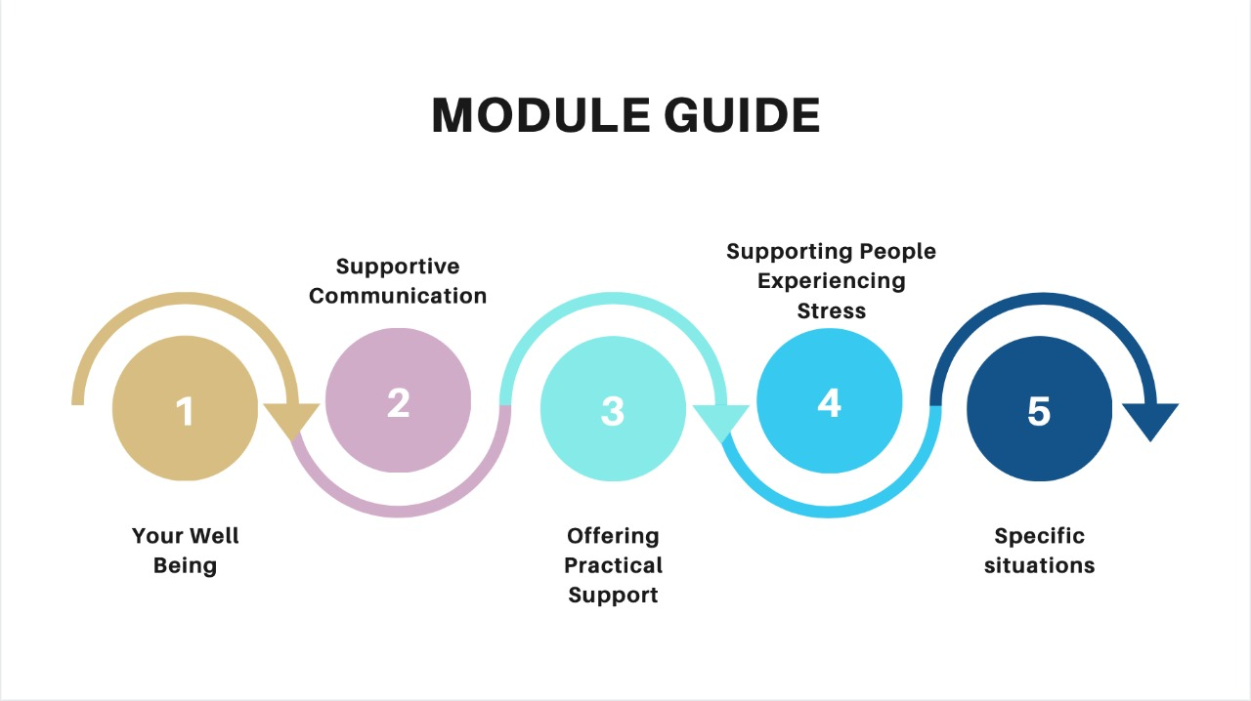
Notes:
This course consists of five modules: Your Wellbeing, Supportive Communication in Everyday Interactions, Offering Practical Support, Supporting People who are Experiencing Stress and Helping People in Specific Situations.
The topics explored in these modules are primarily designed to support frontline workers and can also be applied to any community and personal crisis situations.

Slide 4
Module 4
4.1 Supporting people who are experiencing stress: An Introduction
Notes:
Welcome to the fourth module of Basic Psychosocial Skills for First Responders. In this module we will be discussing ‘Supporting People Who are Experiencing Stress’. We will look at common and severe stress reactions and how to support someone who is showing these stress symptoms.

Slide 5
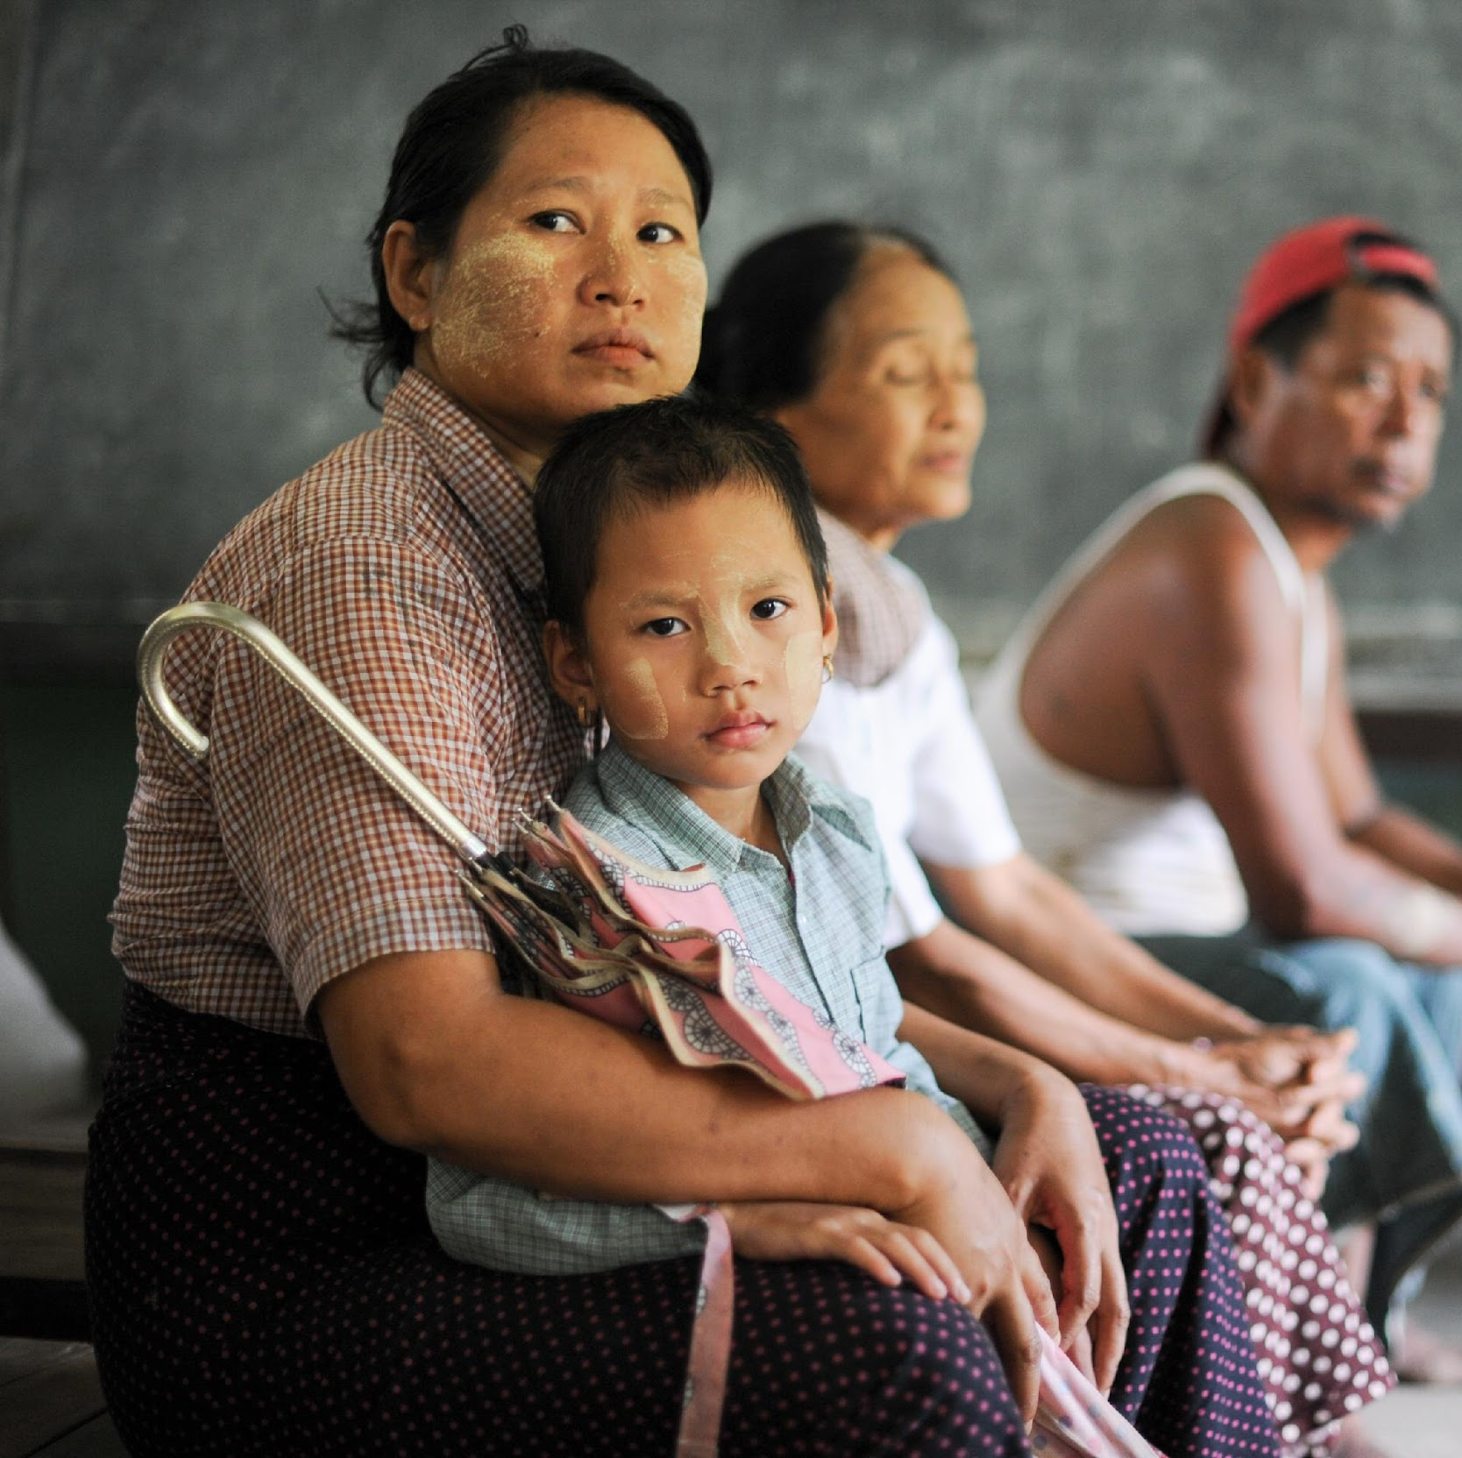
Being a frontline worker, you may come across people who show signs of extreme stress. It is natural to show these signs of stress during a crisis.
Notes:
Being a frontline worker, you may come across people who show signs of extreme stress. Signs of stress are natural reactions, when a person experiences a crisis.

Slide 6
What is stress?
Notes:
What do you think stress is?

Slide 7
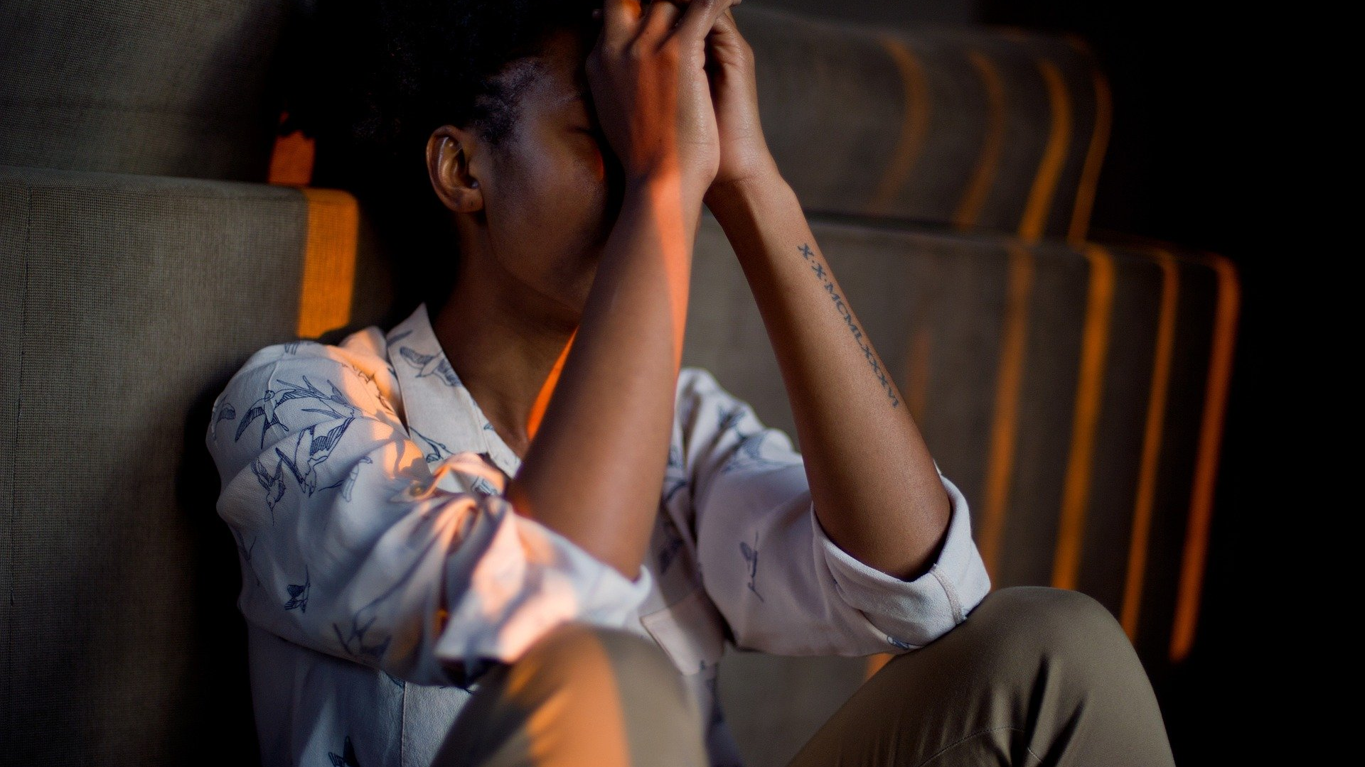
Stress is a natural reaction, and one which everyone experiences. It is a sign of discomfort towards a particular person or an incident.
However we all have different expressions of stress.
Notes:
Stress is a natural reaction, and it is common for everyone. It is a sign of discomfort towards a particular person or an incident.
Stress reactions occur when one person experiences a change or a challenge, it can be good or bad.
However we all have different expressions of stress.

Slide 8
Stress REACTIONs
Notes:
To understand stress, let us look into stress reactions

Slide 9
There are common and severe expressions of stress. Stress can be expressed through
Physical
Mental
Emotional
Behavioural
Notes:
As it is a natural reaction, there are common expressions of stress. Since we all experience it differently, some may also express severe stress reactions.
Stress reactions are expressed
- physically
- mentally
- emotionally
and - through our behaviour

Slide 10
Common Stress Reactions
Notes:
Think of some of your stress reactions
Some of the common stress reactions are

Slide 11
Physical
Unable to sleep
Fatigue
Headache
Muscle pain
Notes:
Physical - being unable to sleep, feeling fatigue, headaches, muscle pain etc

Slide 12
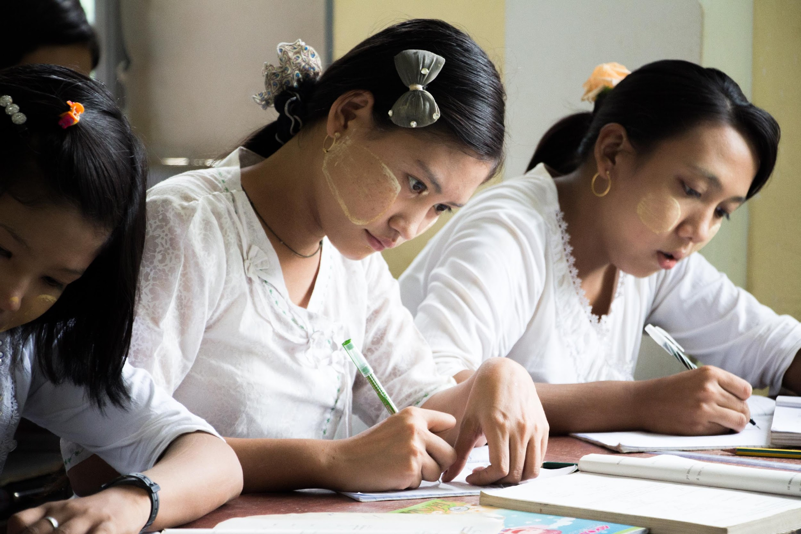
Mental
Unable to concentrate
Forgetfulness
Overthinking
Frustrated
Notes:
Mental - difficulty in concentration, forgetfulness, overthinking, feeling frustrated etc

Slide 13
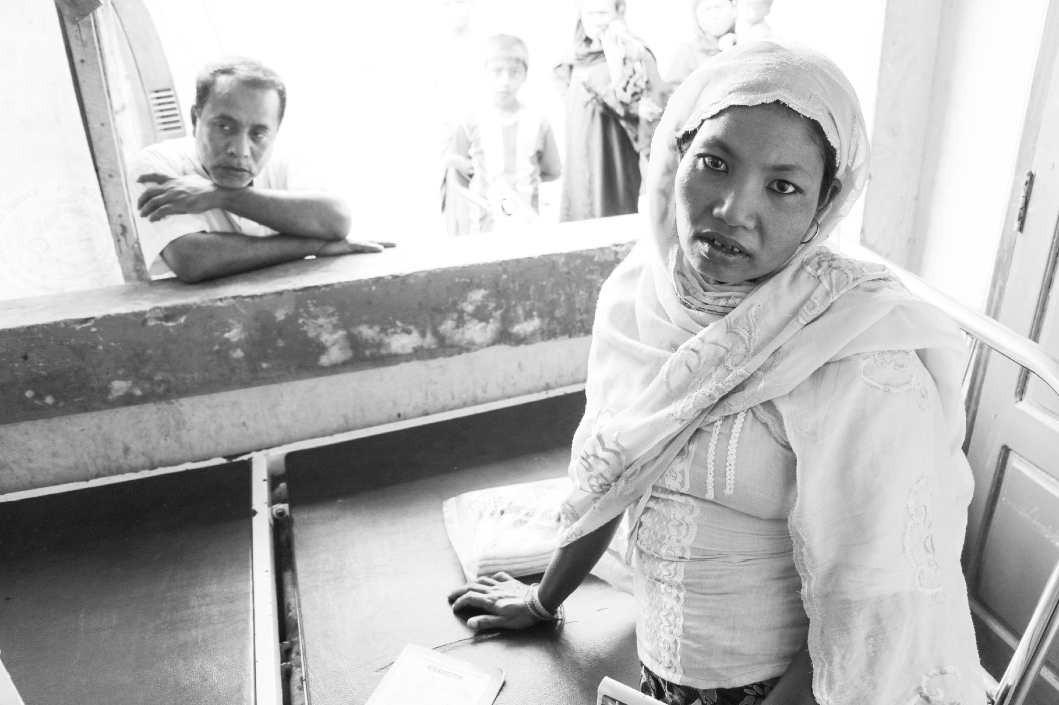
Emotional
Feeling low
Angry
Feeling hopeless
Scared
Notes:
Emotional - feeling down/low, angry, feeling hopeless and scared

Slide 14
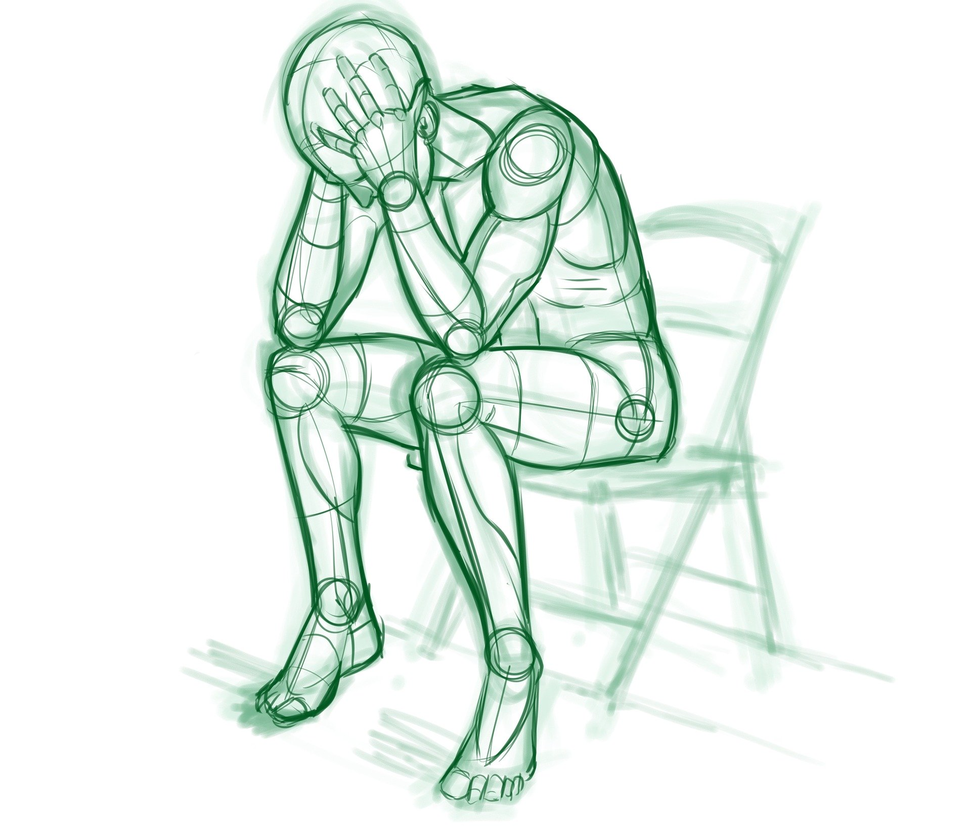
Behavioral
Violent behavior
Avoiding people
Wanting to be alone
Less active
Notes:
and Behavioral - episodes of violent behavior, avoiding people, wanting to be alone, being less active etc

Slide 15
Module 4
4.2 Supporting people with common stress
Notes:
This video will discuss about how to support people with common stress

Slide 16
Supporting people who are experiencing common stress reactions
Notes:
How can you support a person who is experiencing common stress reactions?

Slide 17
The supportive communication skills described in Module 2 may be enough to help someone feel better.
How you present yourself
Active listening
Showing Empathy
If a person requires more support, the following may help.
Notes:
Since stress is a natural and common reaction, you can help someone to feel calm by engaging in supportive communication.
Let’s try to revise some of the skills discussed in module 2 ‘Supportive Communication in Everyday Interactions’
The supportive communication skills described in Module 2 may be enough to help someone feel better.
How you present yourself
Actively listening
and
Show Empathy
If a person requires more support, the following might help

Slide 18
First encourage the person to think of something they can do to feel better. People may already have things they do to help themselves in stressful situations. To support them to draw on this knowledge, ask the person.
Notes:
First encourage the person to think of something they can do to feel better People may already have things they do to help themselves in stressful situations. To support them to draw on this knowledge, ask the person, “What has helped you previously when you have felt this way?” or “What do you currently do to help yourself feel better?”

Slide 19
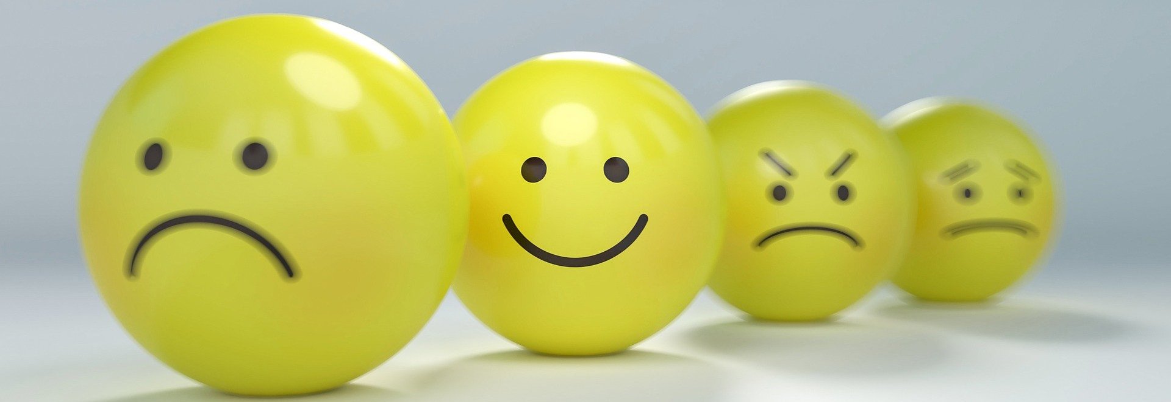
You can provide them with prompts if they struggle to think of something
Notes:
You can provide them with prompts if they struggle to think of something, e.g. “Is there anyone who can help you?”; “Are there any activities you used to enjoy doing that you could do?”.

Slide 20
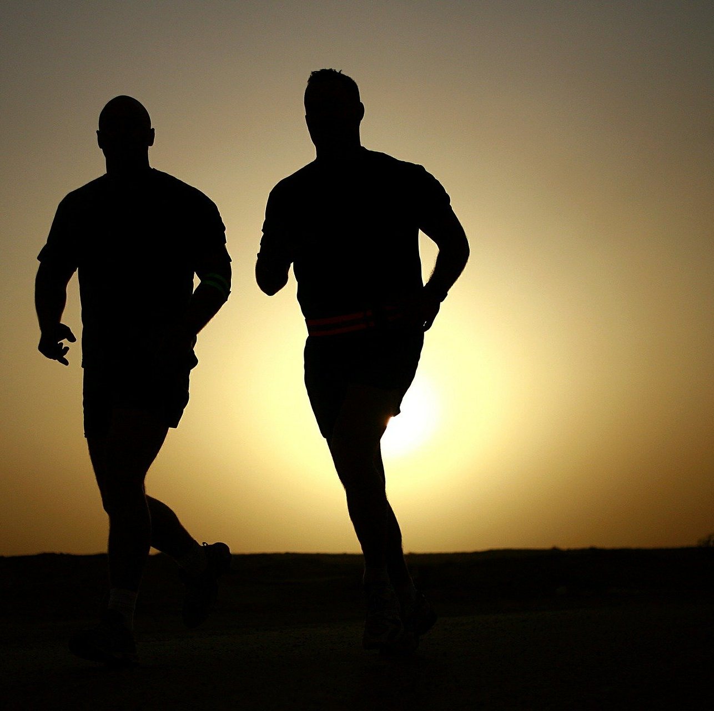
You can encourage healthy activities (exercising) and discourage unhealthy activities (overuse of alcohol/smoking)
Notes:
More importantly, you encourage healthy activities (like exercising and having enough sleep) and discourage unhealthy activities (like overusing alcohol/cigarettes or other substances)

Slide 21
Some things that the person can try to feel better
If a person cannot think of anything they can do to help themselves, you can make suggestions like the following.
Notes:
If a person cannot think of anything they can do to help themselves, you can even make suggestions like following.

Slide 22
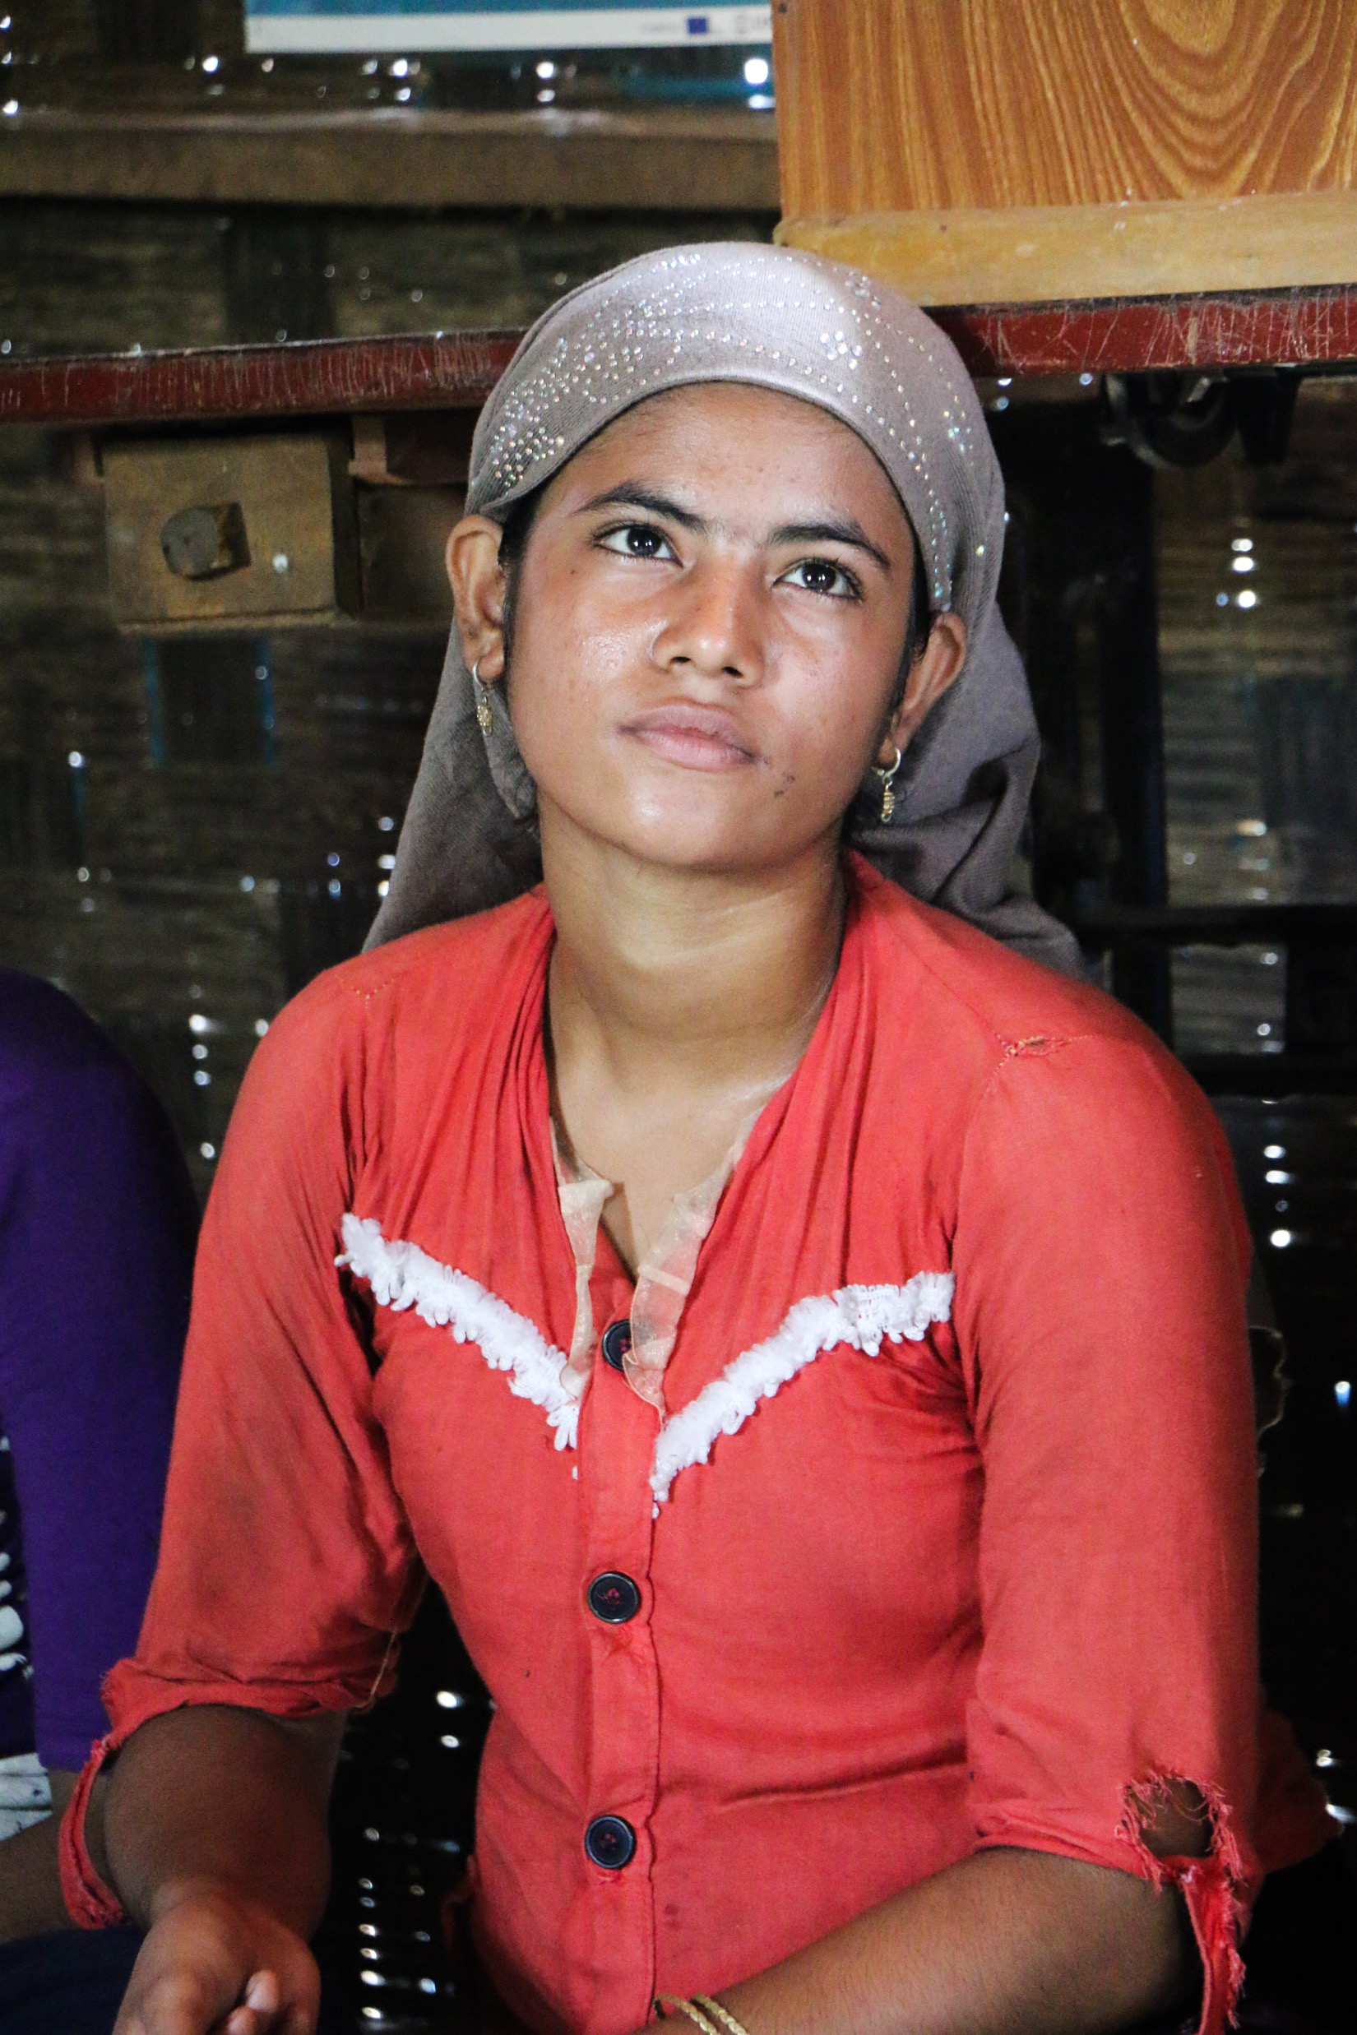
Make a list of all the things you are grateful for (in your head or on paper).
Notes:
Make a list of all the things you are grateful for (in your head or on paper).

Slide 23
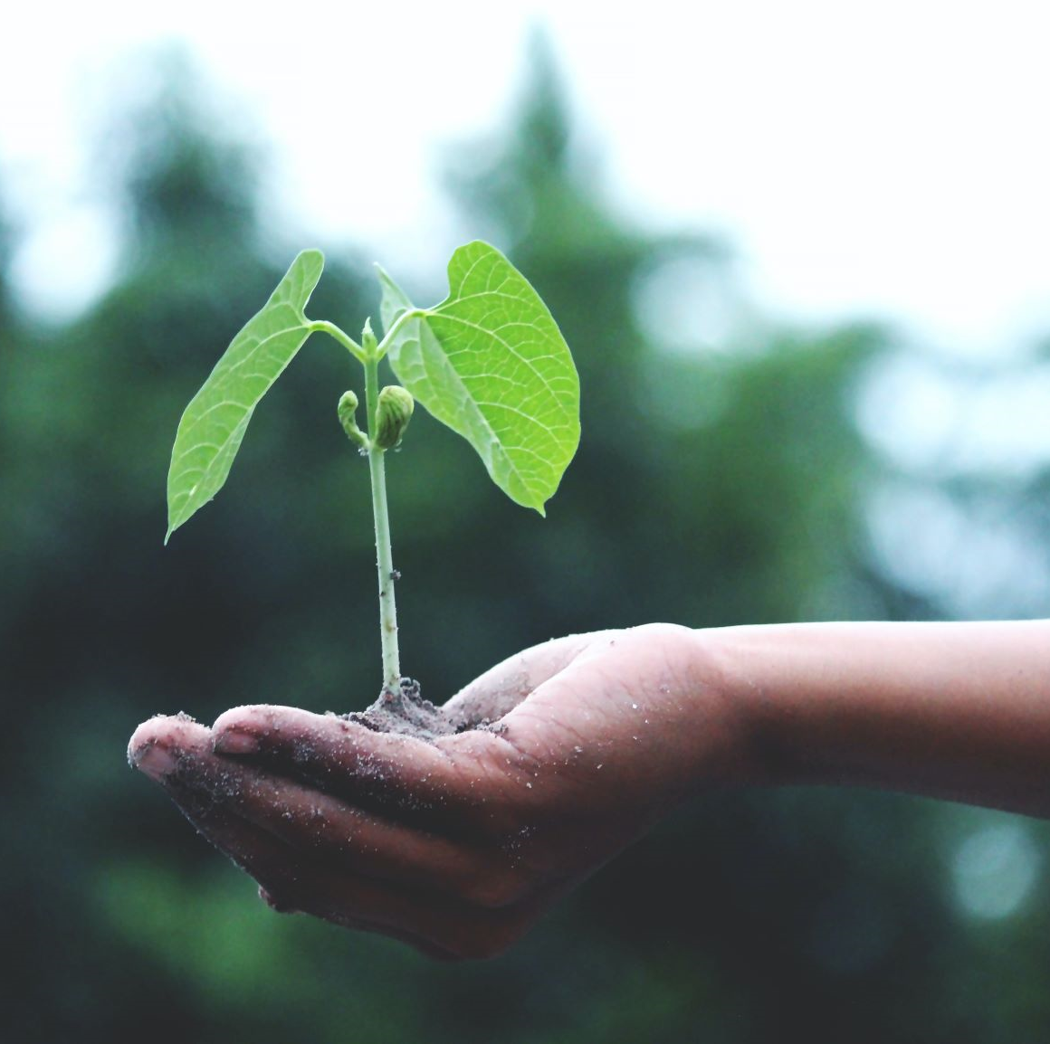
Try to find time to do an activity you enjoy (a hobby) or find meaningful every day.
Notes:
Try to find time to do an activity you enjoy (a hobby) or find meaningful every day.

Slide 24
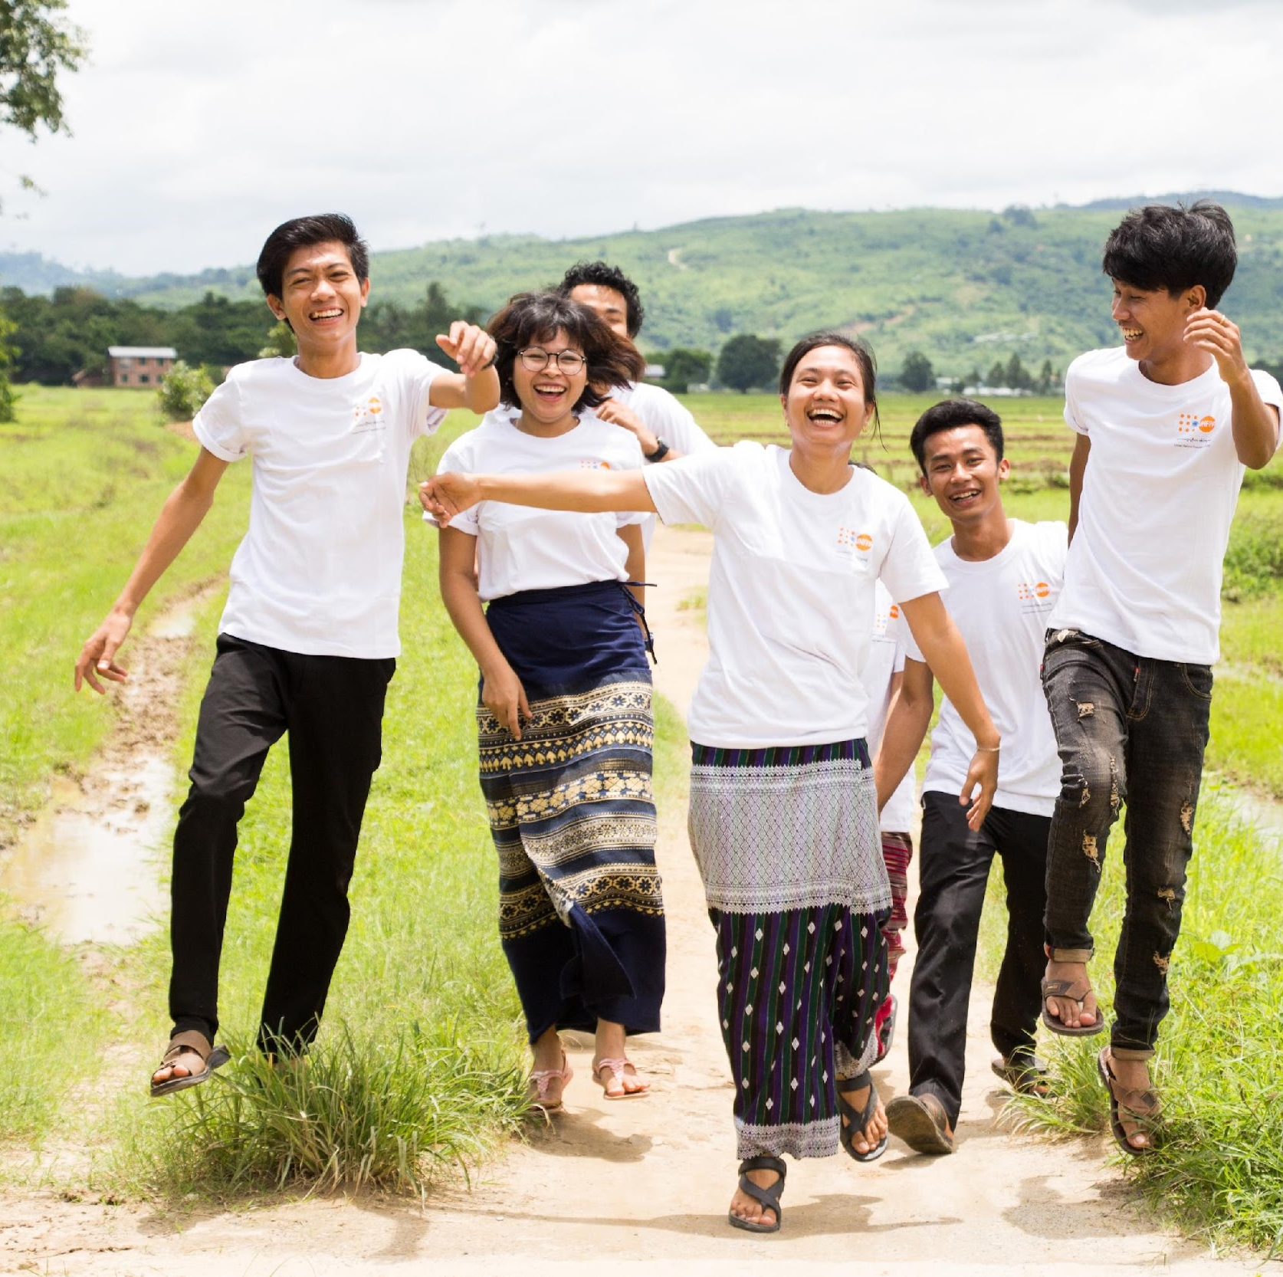
Exercise, walk or dance.
Notes:
Engage in a physical activity you would enjoy. Example: Exercise, walk or dance.

Slide 25
Do something creative, such as art, singing, crafts or writing.
Notes:
Do something creative, such as art, singing, crafts or writing.

Slide 26
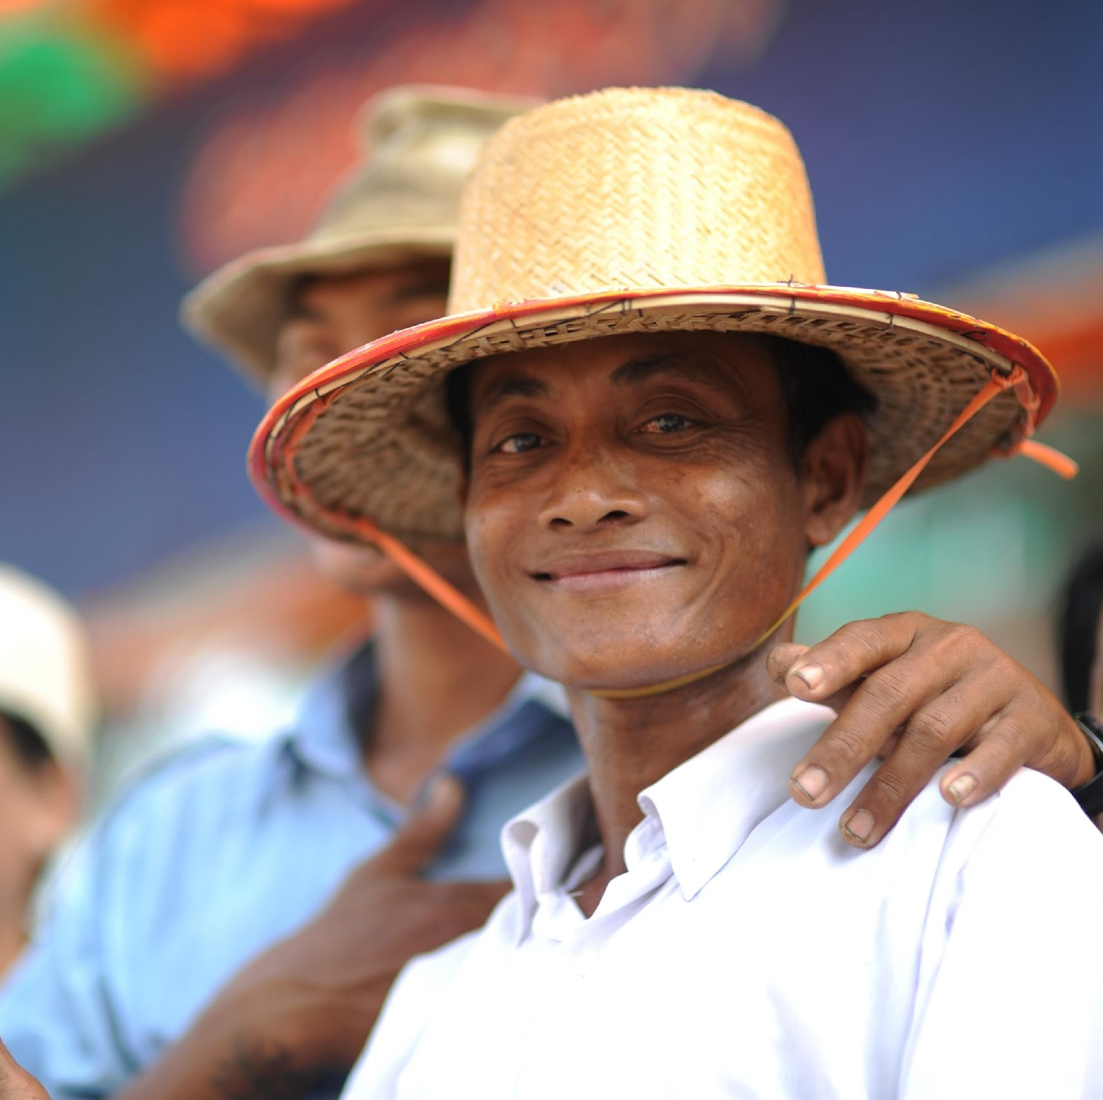
Listen to music or the radio.
Notes:
Listen to music or the radio.

Slide 27
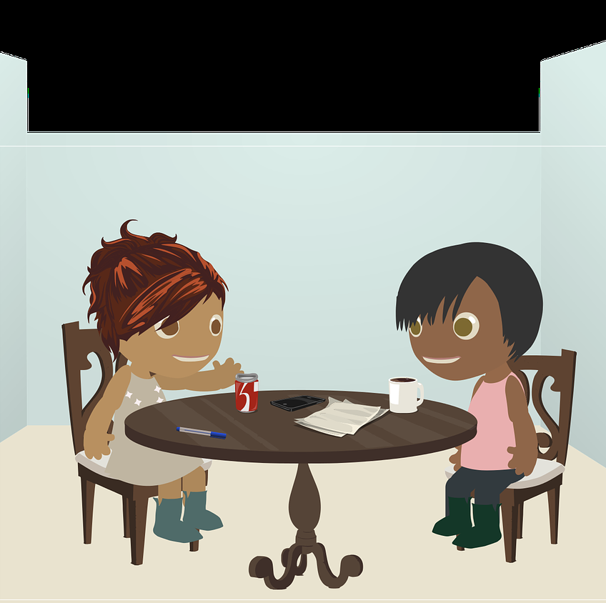
Speak to a friend or family member.
Notes:
Speak to a friend or family member.

Slide 28
Read a book or listen to an audiobook.
Notes:
Read a book or listen to an audiobook.

Slide 29
You can also think of other ways which help a person relax
Notes:
Just like stress reactions, modes of relaxing may also differ from person to person. Thus, you can also think of other way apart from the above suggestions, that can help a person relax or help them identify positive coping strategies.

Slide 30
Module 4
4.3 Identifying severe stress reactions
Notes:
How to identify severe distress reactions

Slide 31
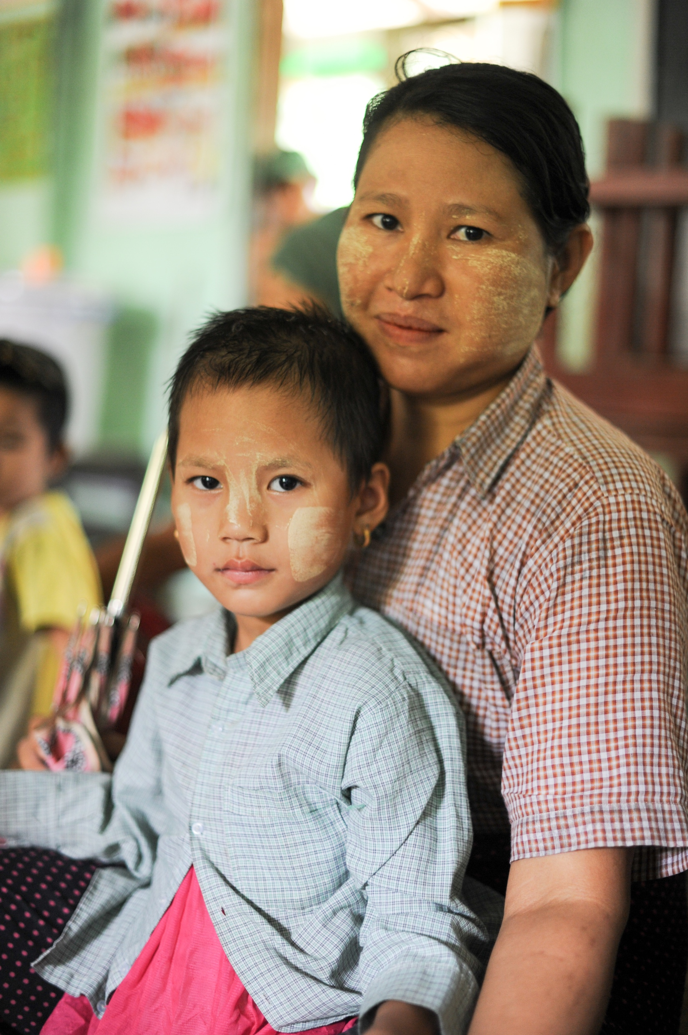
Severe Stress Reactions
Notes:
Hope you have understood stress and its common signs.
Now let’s have a look at how severe stress reactions may be expressed by a person who is seeking your help:

Slide 32
Is unable to sleep for a week or more and is confused and disorientated
Notes:
When the person is unable to sleep for a week or more and is confused and disoriented.

Slide 33
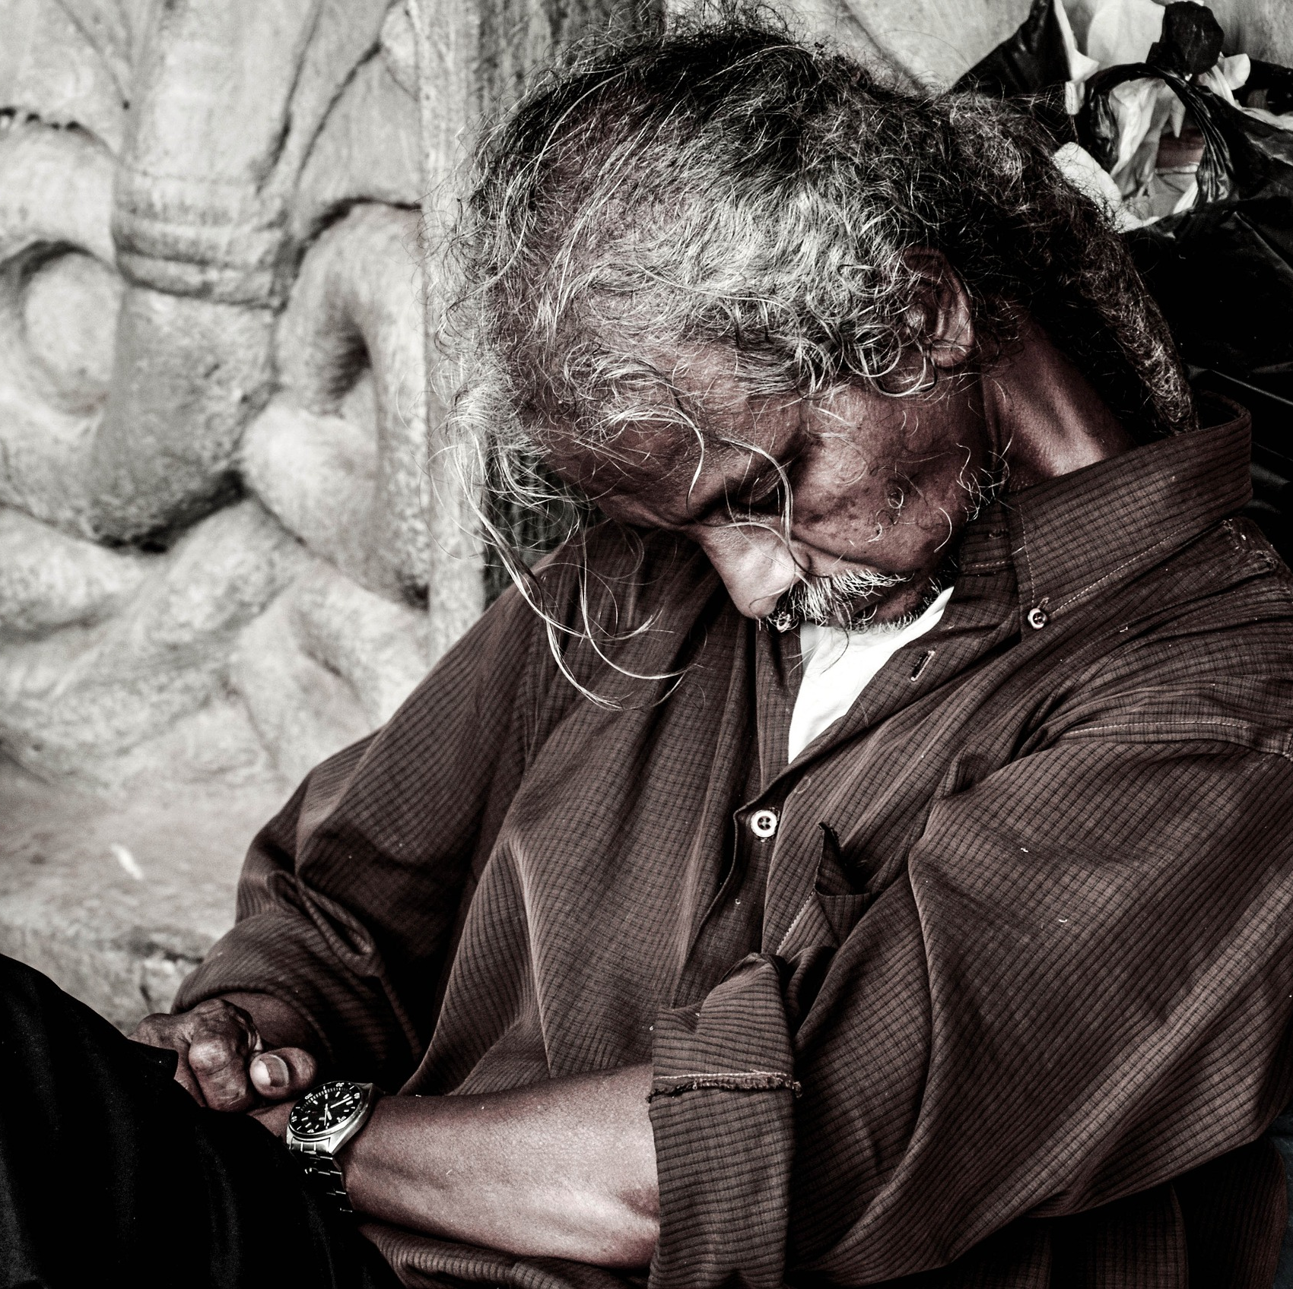
Unable to function normally and care for themselves or their family (e.g. not eating or keeping clean)
Notes:
When the person is unable to function normally and care for themselves and their family (e.g. not eating or keeping clean)

Slide 34
Has lost control over their behaviour and is unpredictable or destructive
Notes:
When the person has lost control over their behaviour and is unpredictable or destructive

Slide 35
Threatens to harm themselves or others
Notes:
when the person threatens to harm themselves of others

Slide 36
Starts excessive or out-of-the-ordinary use of drugs or alcohol
Notes:
when the person shows signs of using excessive or out-of-the-ordinary use of drugs or alcohol

Slide 37
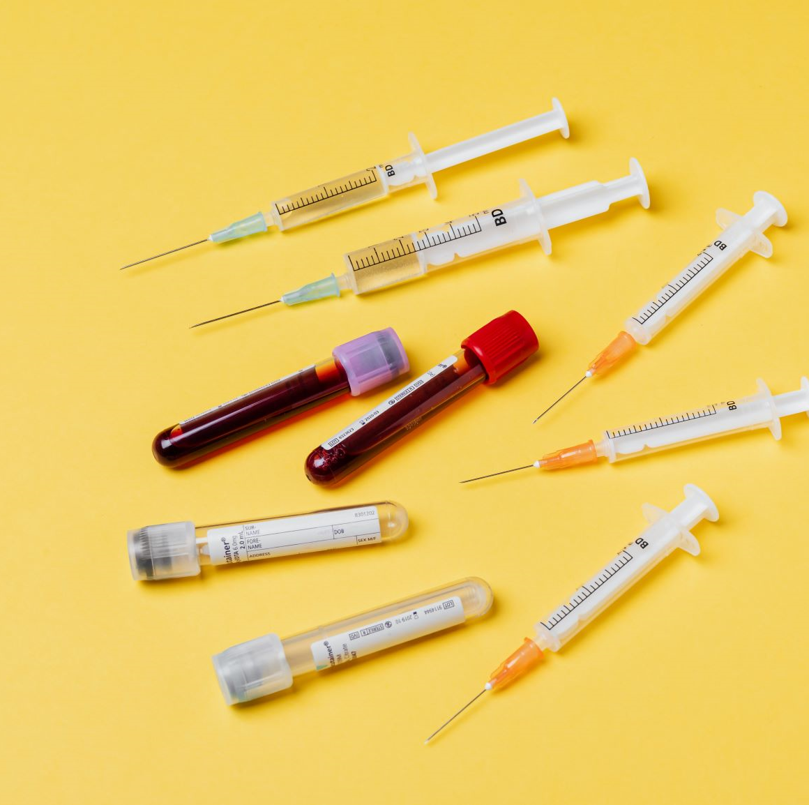
Aggravates existing chronic health conditions which need specialized support
Notes:
When the person’s chronic health conditions are aggravates (like amnesia, hypertension, diabetes, lower back pain etc ), which need specialised support

Slide 38
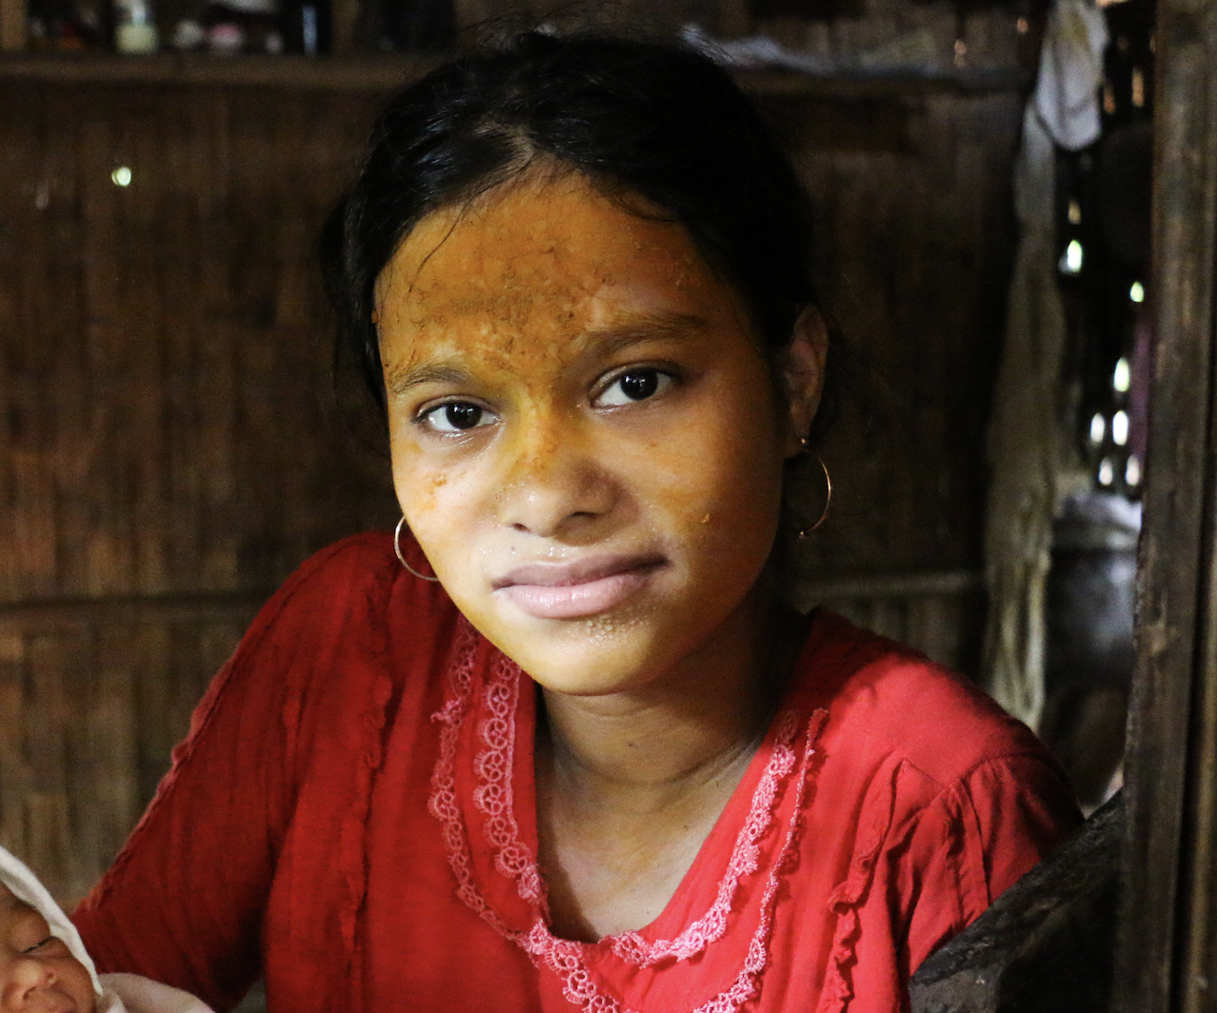
Shows bizarre or unusual thinking, or hears or sees things that aren’t there
Notes:
and for a few people extreme stress can cause them lose in touch with reality, leading them to experience bizarre or unusual thinking or hear or see things that are not there

Slide 39
If a person presents with any of these signs or symptoms, then you should try to help the person in distress access additional help as soon as possible.
Notes:
IF A PERSON PRESENTS WITH ANY OF THESE SIGNS OR SYMPTOMS, THE YOU SHOULD TRY TO HELP THE PERSON IN DISTRESS ACCESS ADDITIONAL HELP AS SOON AS POSSIBLE.
When this happens, they might be seriously distressed.
Feeling serious distress is a normal reaction to extraordinary circumstances, but it can stop people being able to function.
In a situation like this, it is likely that you will need to refer the person on to specialized support.

Slide 40
Module 4
4.4 Supporting people in serious distress
Notes:
This video will look at supporting people in serious distress

Slide 41
What to do when you encounter someone in serious distress
Notes:
How can you help, when you encounter someone in serious distress?

Slide 42
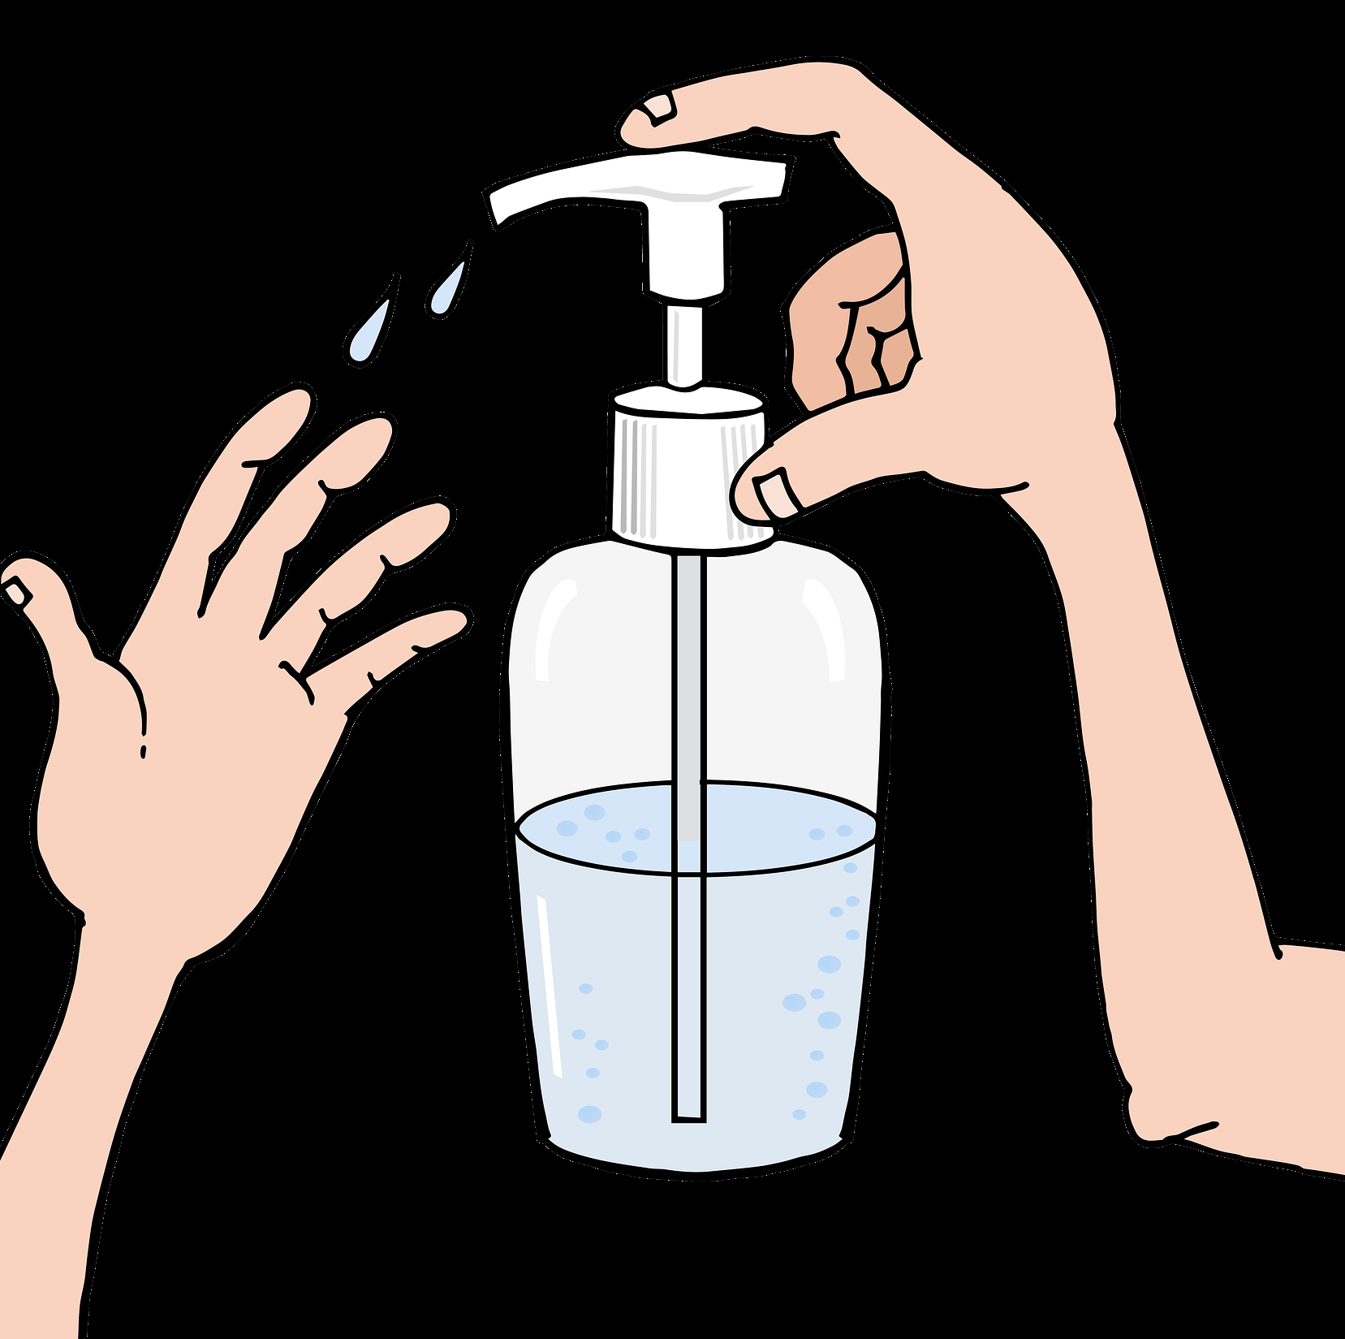
1. Safety first
Make sure that you, the person and others are safe from harm. If you feel unsafe, leave and get help. If you think the person may hurt themselves, get help.
Take preventative measures against COVID-19 infection (e.g. physical distancing).
When seeking help respect dignity of yourself and others and maintain confidentiality
Do NOT put yourself at risk.
Notes:
SAFETY FIRST-
Make sure that you, the person and others are safe from harm. If you feel unsafe, leave and get help. If you think the person may hurt themselves, get help (ask a colleague, call emergency services, etc.).
Take preventative measures against COVID-19 infection (e.g. physical distancing).
When seeking help respect dignity of yourself and others and maintain confidentiality
Do NOT put yourself at risk.

Slide 43
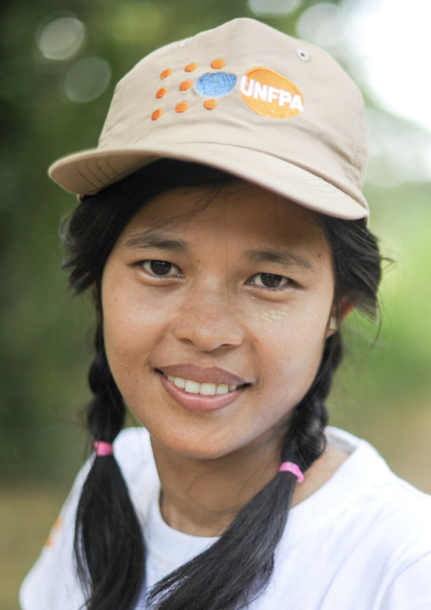
2. Let them know who you are
Introduce yourself clearly and respectfully – your name and your role, and that you are there to help.
Ask them for their name so that you can address them.
Notes:
LET THEM KNOW WHO YOU ARE
-Introduce yourself clearly
and respectfully – your name and your role, and that you are there to help.
Ask them for their name so that you can address them.

Slide 44
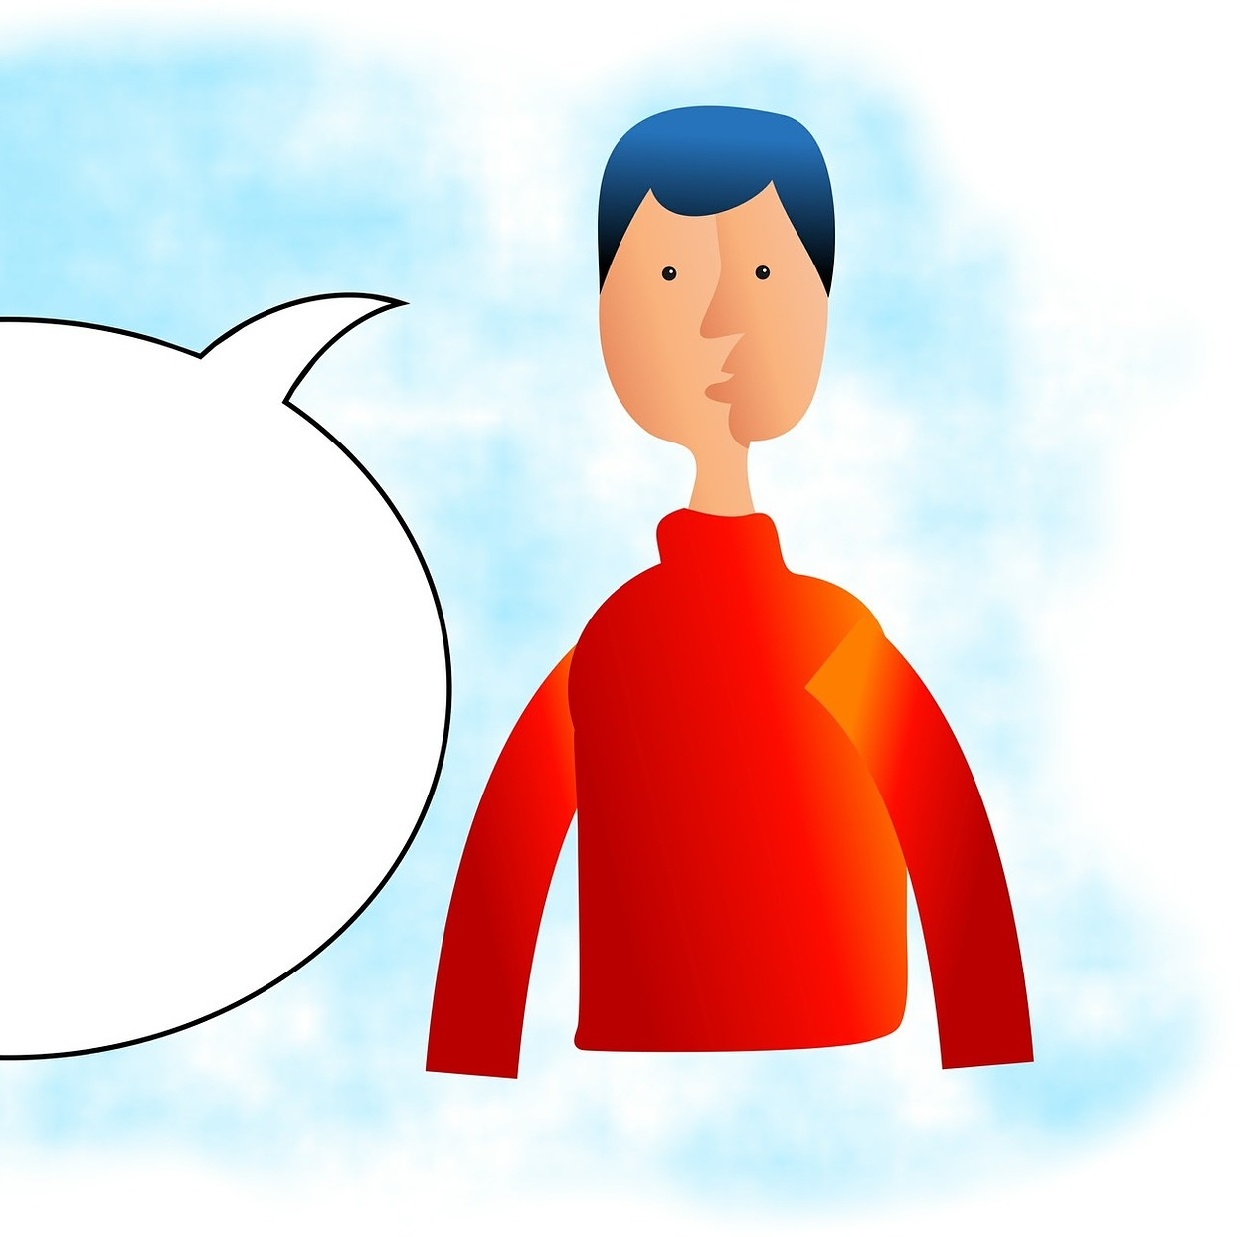
3. Keep calm
Don’t shout at the person or physically restrain them.
Notes:
ALWAYS KEEP CALM-
Don’t shout at the person or physically restrain them.

Slide 45
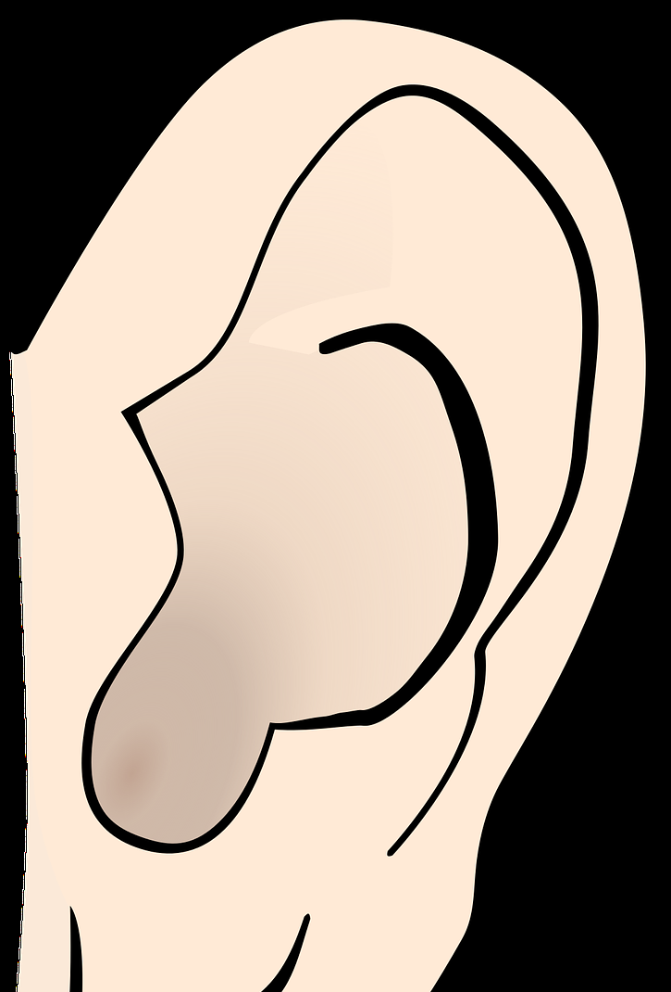
4. Listen
Use your communication skills
Do not pressure the person to talk.
Be patient and reassure them that you are there to help and to listen.
Notes:
LISTEN to THE PERSON-
Use your communication skills, as described in Module 2.
Do not pressure the person to talk.
Be patient and reassure them that you are there to help and to listen.

Slide 46
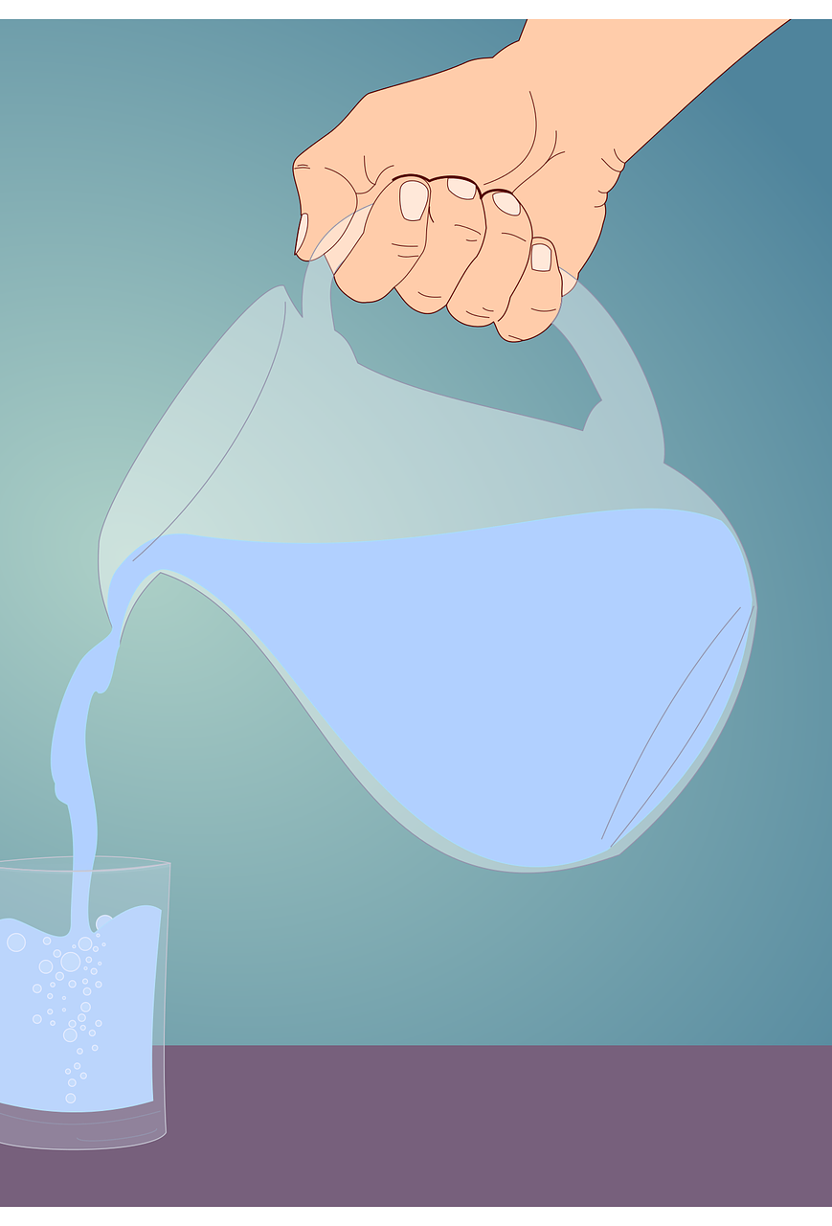
5. Offer practical comfort and information
If possible, offer the person a quiet place to talk, some water and make the person feel comfortable.
These gestures of comfort will help them feel safe.
Ask them what they need – don’t assume that you know.
Notes:
OFFER PRACTICAL COMFORT and INFORMATION-
If possible, offer the person a quiet place to talk, some water and make the person feel comfortable (offering a chair to sit or a place to lie down, a clean towel dipped in warm water to wipe their face).
These gestures of comfort will help them feel safe. Ask them what they need – don’t assume that you know.

Slide 47
6. Help people regain control
If the person is anxious, support them to breathe slowly
If the person is out of touch with their surroundings, remind them where they are, the day of the week and who you are. Ask them to notice things in their immediate environment
Help them to use their own good coping strategies and to reach out to supportive people in their lives.
Notes:
HELP PEOPLE REGAIN CONTROL-
to do this follow these three steps
a. If the person is anxious, support them to breathe slowly – see “slow breathing” technique in additional resources
b. If the person is out of touch with their surroundings, remind them where they are, the day of the week and who you are. Ask them to notice things in their immediate environment (e.g. “Name one thing you see or hear”).
c. Help them to use their own good coping strategies and to reach out to supportive people in their lives.

Slide 48
7. Provide clear information
Give reliable information to help the person understand the situation and what help is available.
Keep the message simple and repeat it or write it down if needed.
Ask them if they understand or have any questions.
Notes:
PROVIDE CLEAR INFORMATION-
Give reliable information to help the person understand the situation and what help is available. Make sure that you use words they can understand (not complicated words).
Keep the message simple and repeat it or write it down if needed.
Ask them if they understand or have any questions.

Slide 49
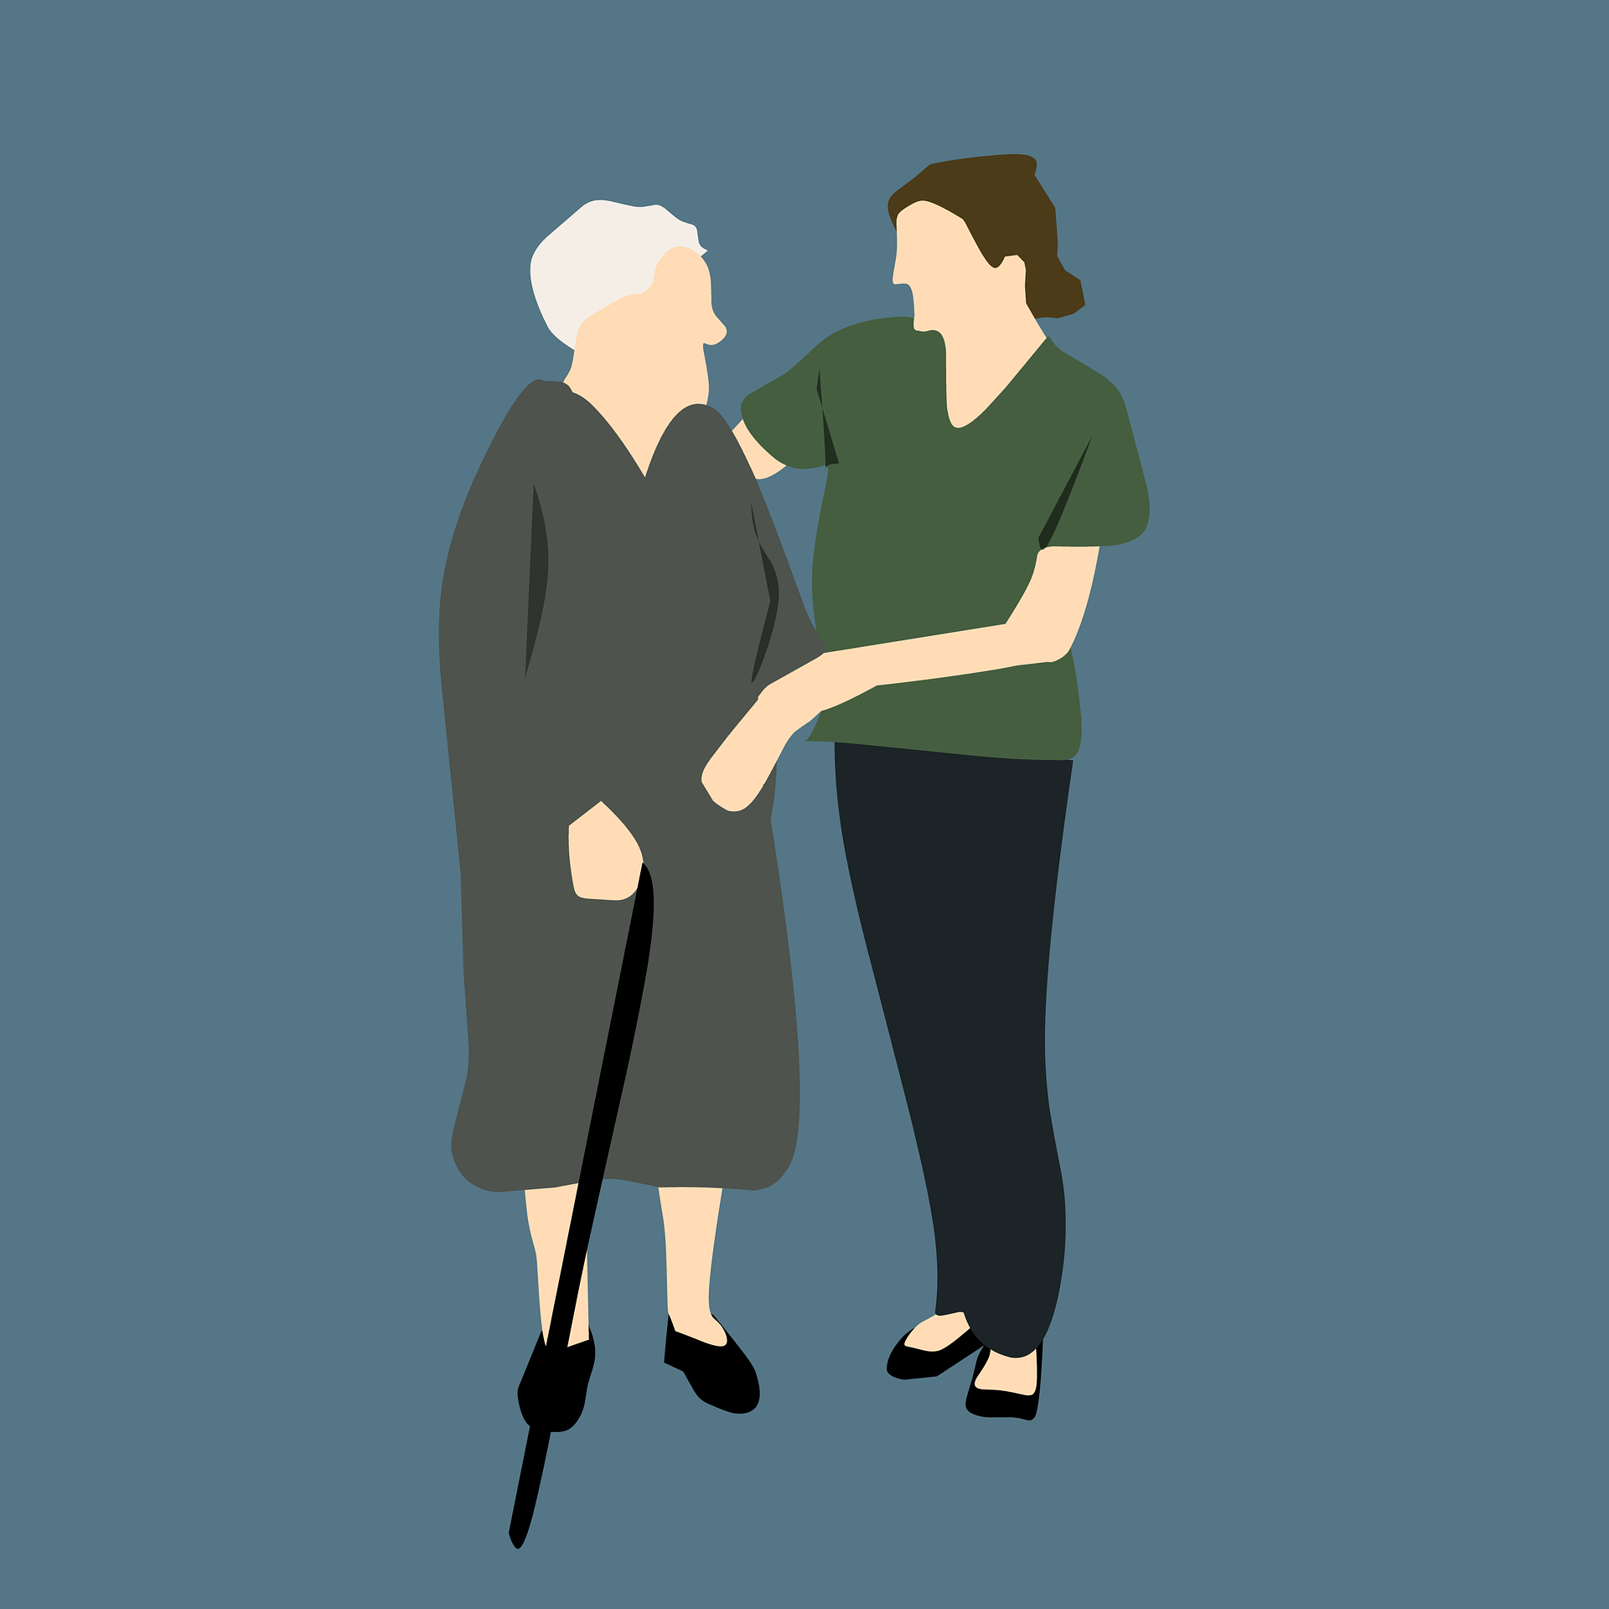
8. Stay with the person
Try not to leave the person alone.
If you can’t stay with them, find a safe person (a colleague, a friend) to be with them until you find help or they feel more calm.
Notes:
STAY WITH THE PERSON-
Try not to leave the person alone.
If you can’t stay with them, find a safe person (a colleague, a friend) to be with them until you find help or they feel more calm.

Slide 50
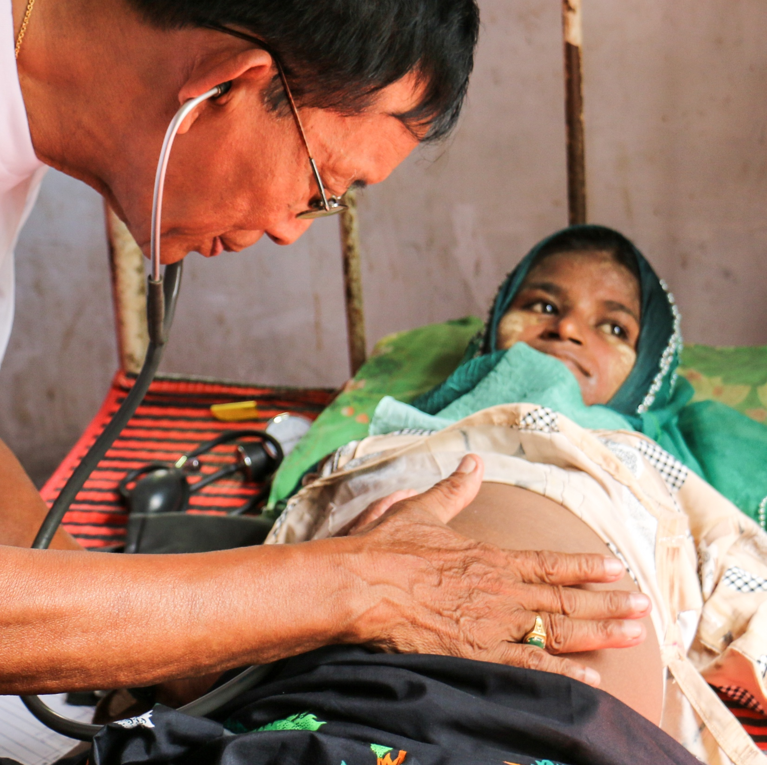
8. Refer to specialised support
Do not go beyond the limits of what you know.
Let others with more specialised skills, such as doctors, nurses, counsellors and mental health professionals, take over.
Link the person directly with support, or make sure they have contact information and clear instructions for getting further help.
Notes:
REFER TO SPECIALIZED SUPPORT-
Do not go beyond the limits of what you know.
Let others with more specialised skills, such as doctors, nurses, counsellors and mental health professionals, take over.
Link the person directly with support, or make sure they have contact information and clear instructions for getting further help.

Slide 51
Module 4
4.5 Important things to remember
Notes:
What are the important things to remember

Slide 52
Do Remember
Notes:
When helping someone in distress, there are certain things to keep in mind as a helper.
and those are:

Slide 53
If you are talking on the phone, try to stay on the line with the person until they calm down and/or you are able to contact support services to go and help directly.
Check that they are comfortable and able to talk.
Notes:
First-
If you are talking on the phone, try to stay on the line with the person until they calm down and/or you are able to contact support services to go and help directly. Check that they are comfortable and able to talk.

Slide 54
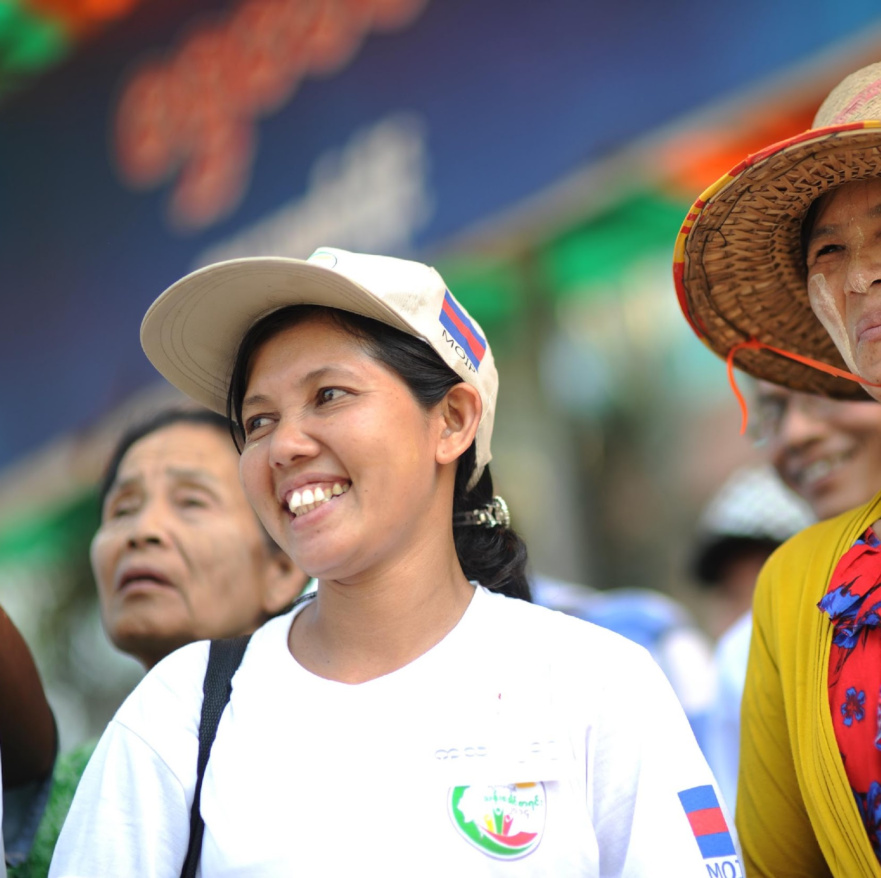
Helping a distressed person is stressful for you as a helper, therefore it is imperative to take care of yourself after providing the needed support.
This is normal and a responsible thing to do.
Notes:
Secondly, and more importantly
Helping a distressed person is stressful for you as a helper, therefore it is imperative to take care of yourself after providing the needed support.
This is normal and a responsible thing to do.

Slide 55
Take some time to breathe and relax after helping someone in severe distress.
(Have a cup of tea/coffee or refreshments, stay quietly for a few minutes/ go for a walk, listen to music etc.)
Notes:
Take some time to breathe and relax after helping someone in severe distress. ( Have a cup of tea/coffee or refreshments, stay quietly for a few minutes/ go for a walk, listen to music etc.)
and these routines can help you as a helper in the long run.

Slide 56
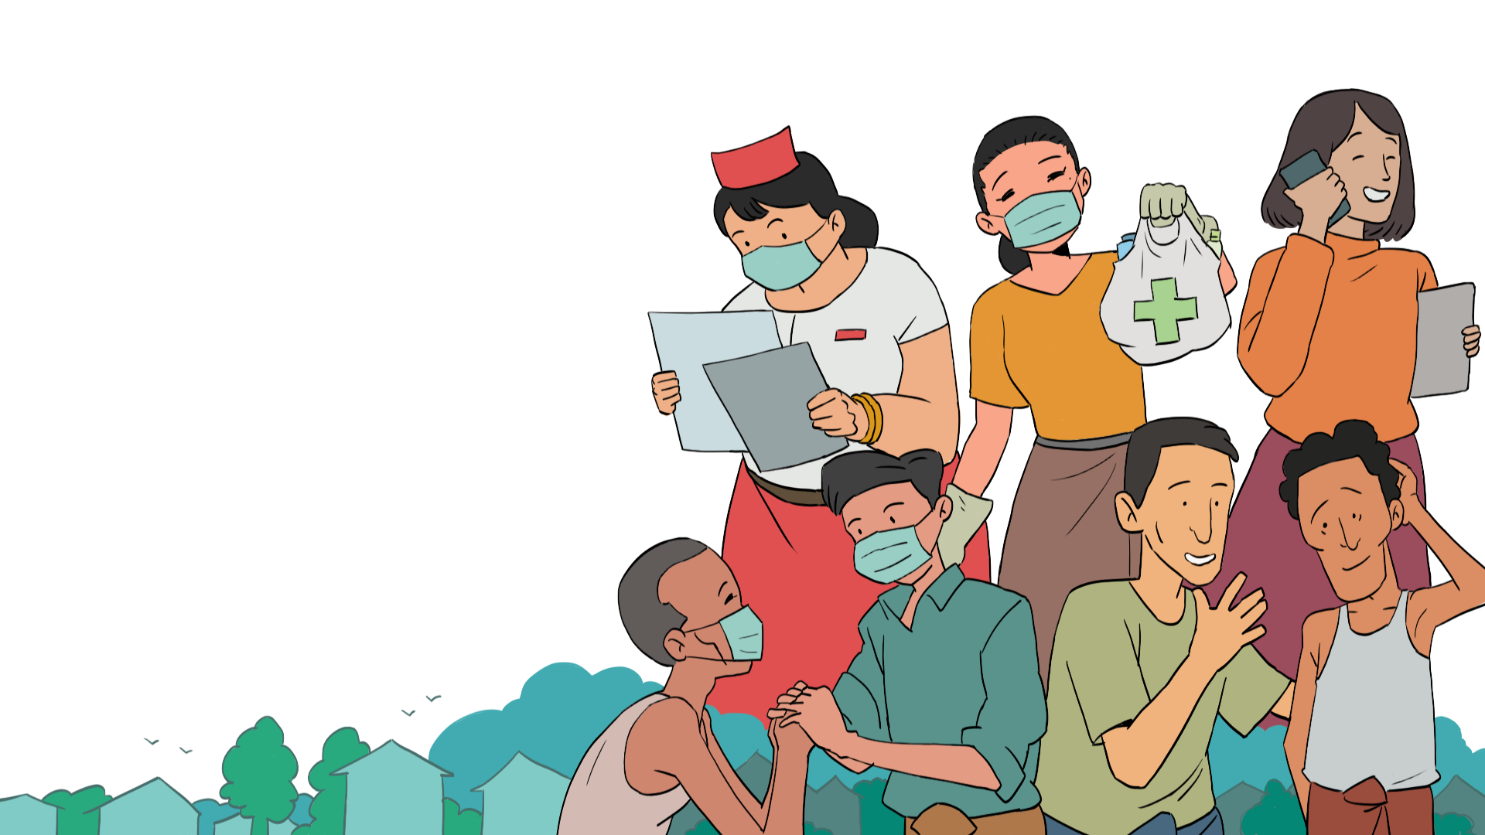
Case Study
Basic Psychosocial Skills +
Notes:
Case Study

Slide 57
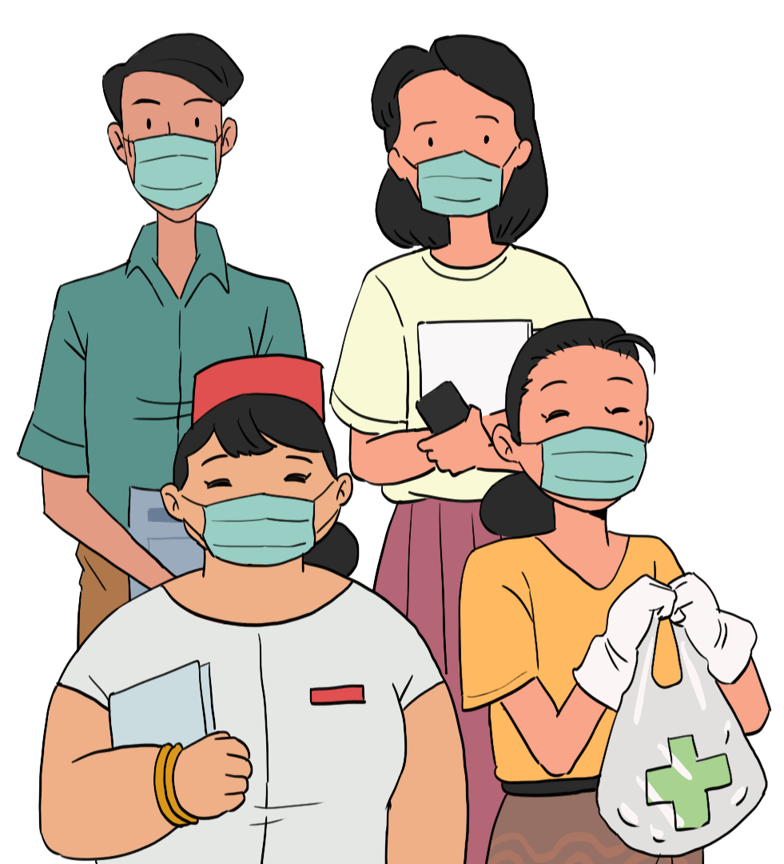
Let's see how Lin Lin helps her friend to identify stress reactions and help relax them.
Notes:
Let's see how Lin Lin helps her friend to identify stress reactions and help relax them.

Slide 58
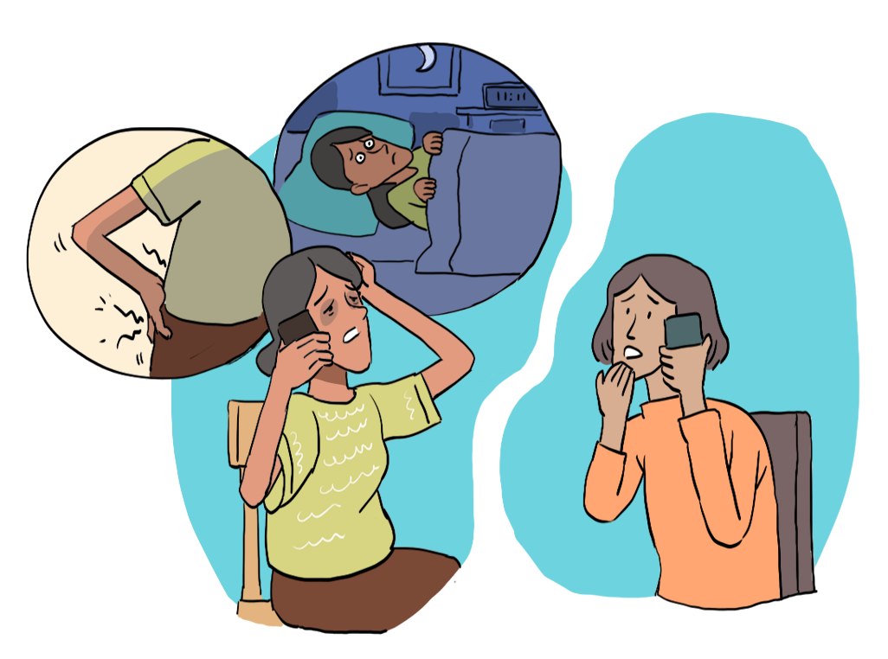
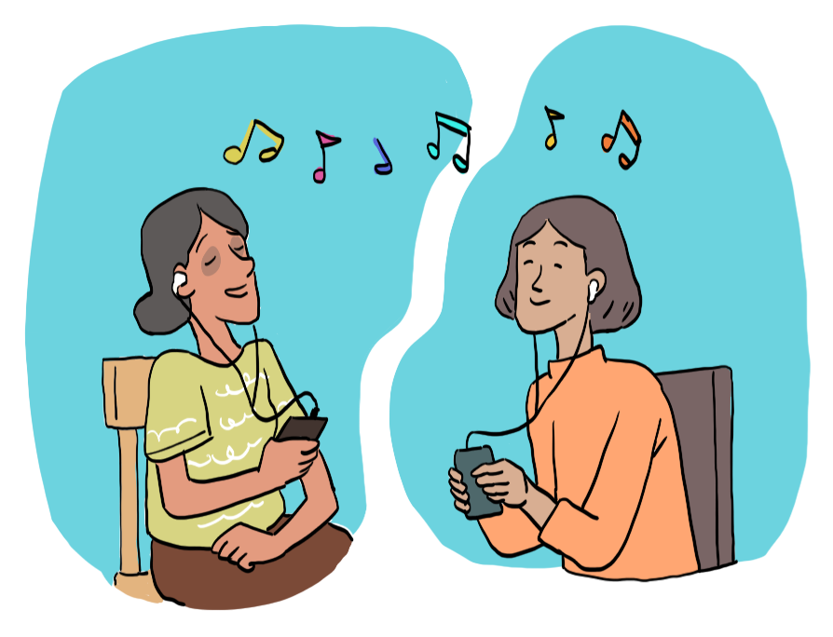
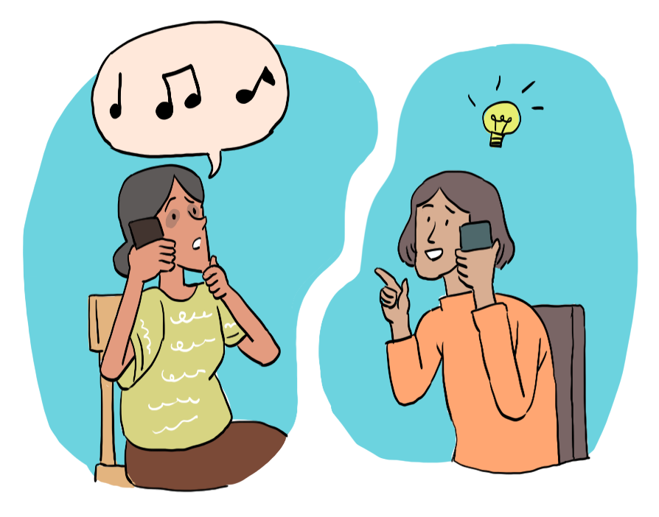
Notes:
Thuzar’s partner has been taken into hospital as he is not well. She is so worried about him that she is not sleeping at night, she cannot eat and she has back pain.
Thuzar is talking to her colleague, Lin Lin, on the phone and tells her how she is feeling. Lin Lin listens to her, and shows her support and care. She asks Thuzar if there is anything she can do to make herself feel better. Thuzar is so tired that she can’t think about anything at the moment. Her back aches so much...
Lin Lin realizes that her colleague is showing signs of stress, so she asks her whether she would like to engage in an activity to take her mind off. Thuzar suggests that she would like to listen to some music as she and her partner would normally do together. Lin Lin tells her what a wonderful idea this is and says she can also listen to the same music to keep Thuzar company.

Slide 59
Module 4 Complete
Next: Module 5
Notes:
You have completed module 4 of Basic Psychosocial skills for first responders in Myanmar. In this module we have looked at common and severe stress reactions and how we can best support someone who is showing these stress symptoms. We hope you have enjoyed this module.
Please take the evaluation for module 4 and then continue to module 5

